Slide 1

Bill Pay
This PowerPoint is going to go through everything you need to know about Bill Pay from enrolling, to adding payees, setting up automatic payments, and more.

Slide 2
What is Bill Pay?
Bill Pay is a third-party system that Cyprus as well as many other financial institutions utilize in order to send either payments to companies, individuals, or other financial institutions.
The payments can be sent via check (which takes about 5-7 business days) or electronically via routing and account number (which takes about 2-3 business days).
Bill Pay can only be used from a checking account.
We can assist the member with various things regarding Bill Pay but if there is something that we cannot assist with, such as stop payments, you will want to cold transfer the member to Bill Pay. Their number is 1-866-827-9724 or you can just dial ext. 7995.

Slide 3
Bill Pay Limits/Features
The starting transaction limit for paying an individual on Bill Pay is $XXXX. The limit for paying a company is $XXXX. The max we can raise either of these limits to is $XXXX.
Cyprus is the one that sets and changes the limits, so do not send the member to Bill Pay support and rather ask the group chat for help.
BillPay will decline any duplicate transactions (to same person for same amount) during that month. If you adjust by even a penny it will work.
The member can add an additional checking account through visiting the Bill Pay site but it will have to be verified on our end before they can use it. We will go over this more in this training.

Slide 4
Enrolling in Bill Pay!

Slide 5
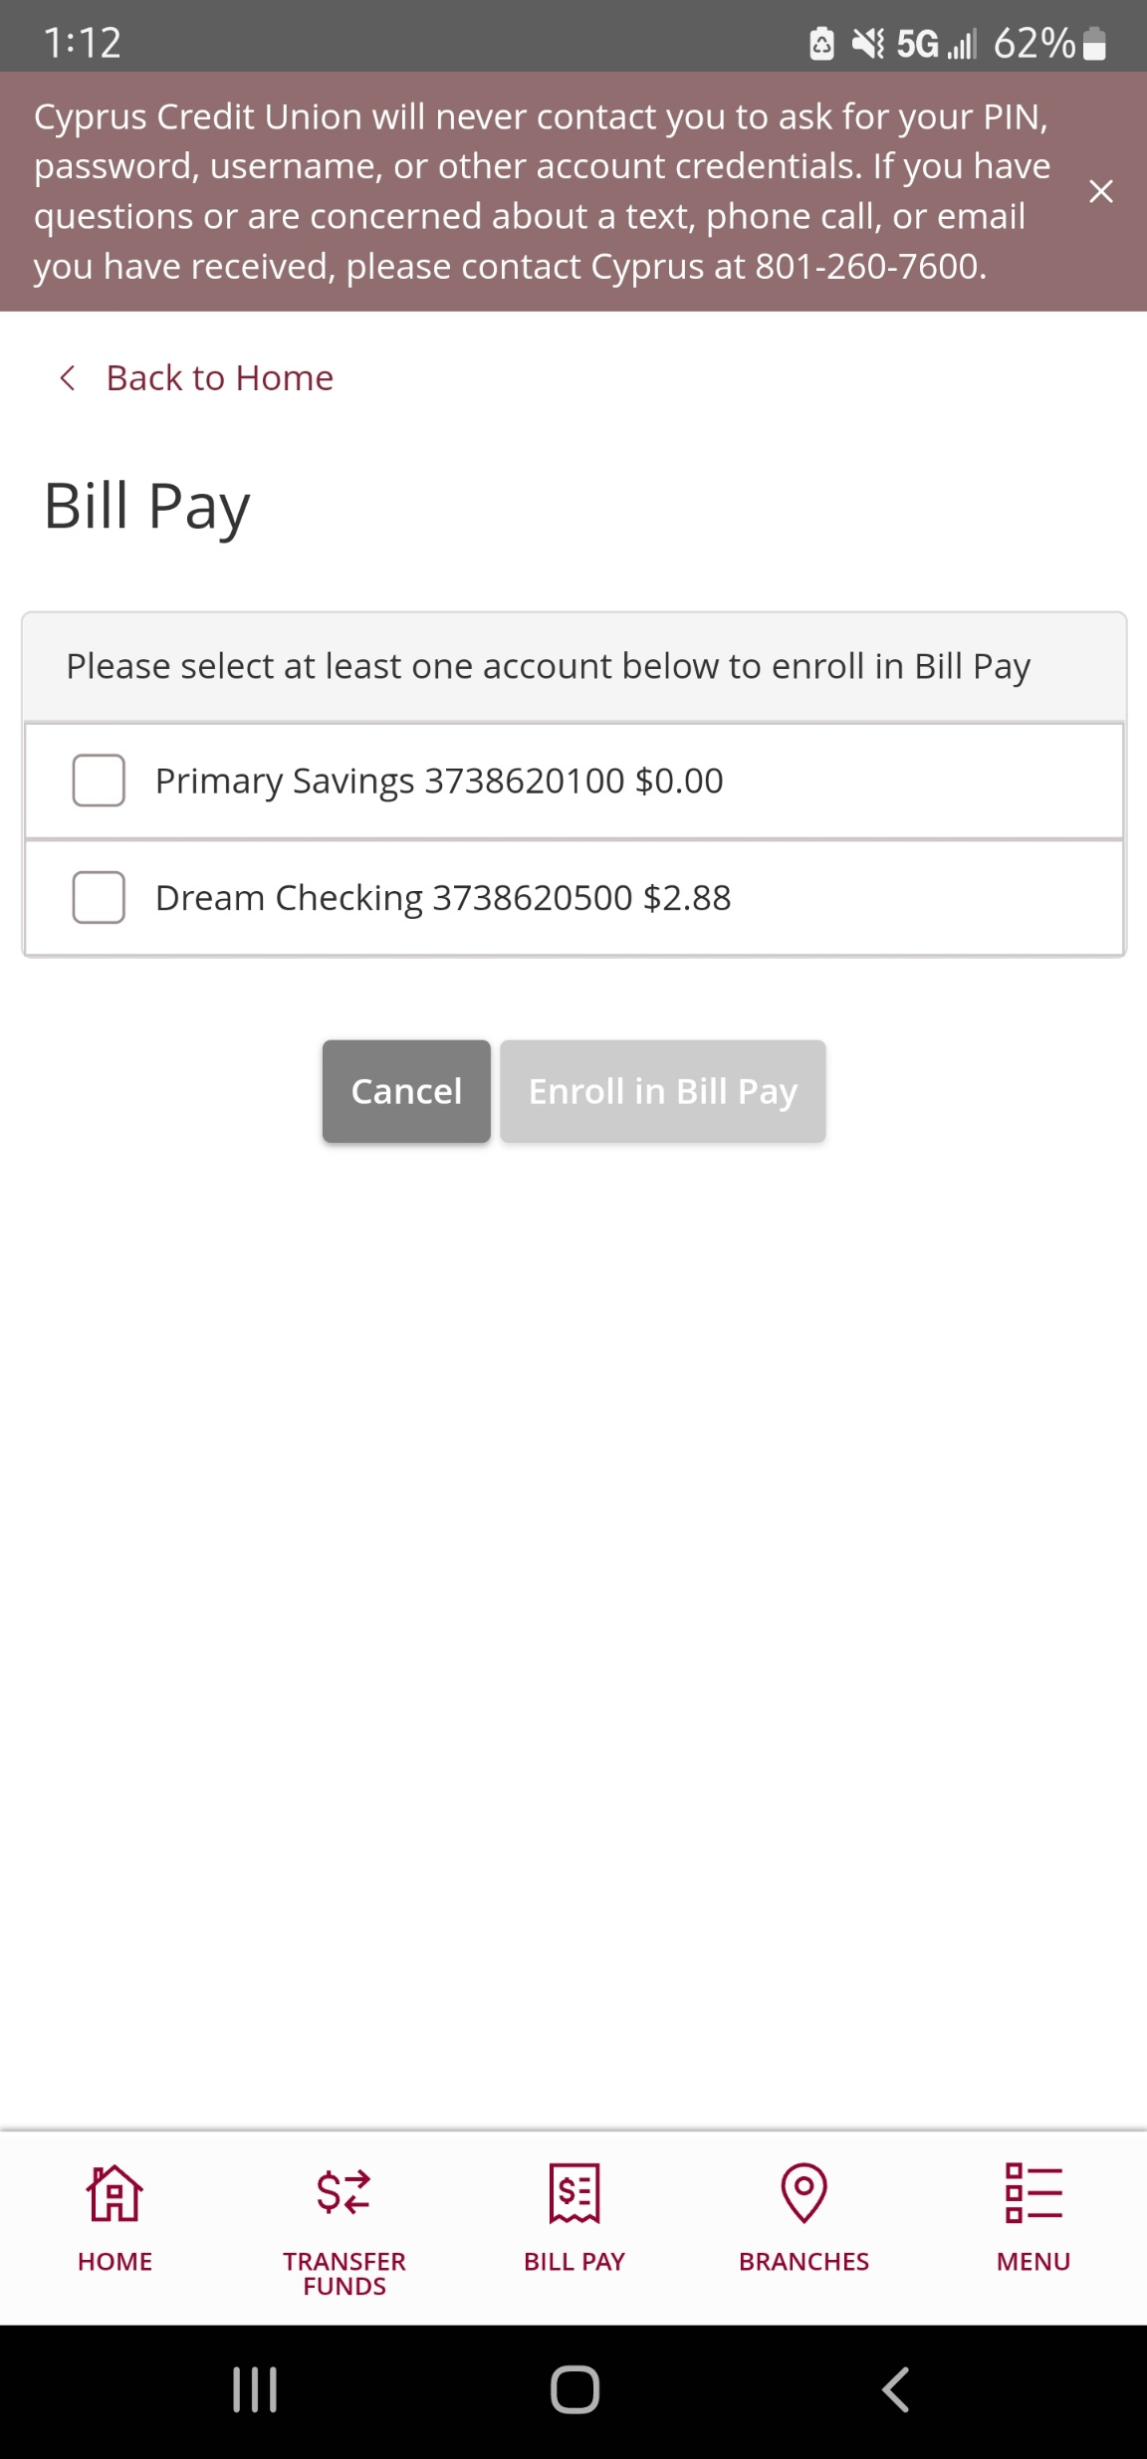
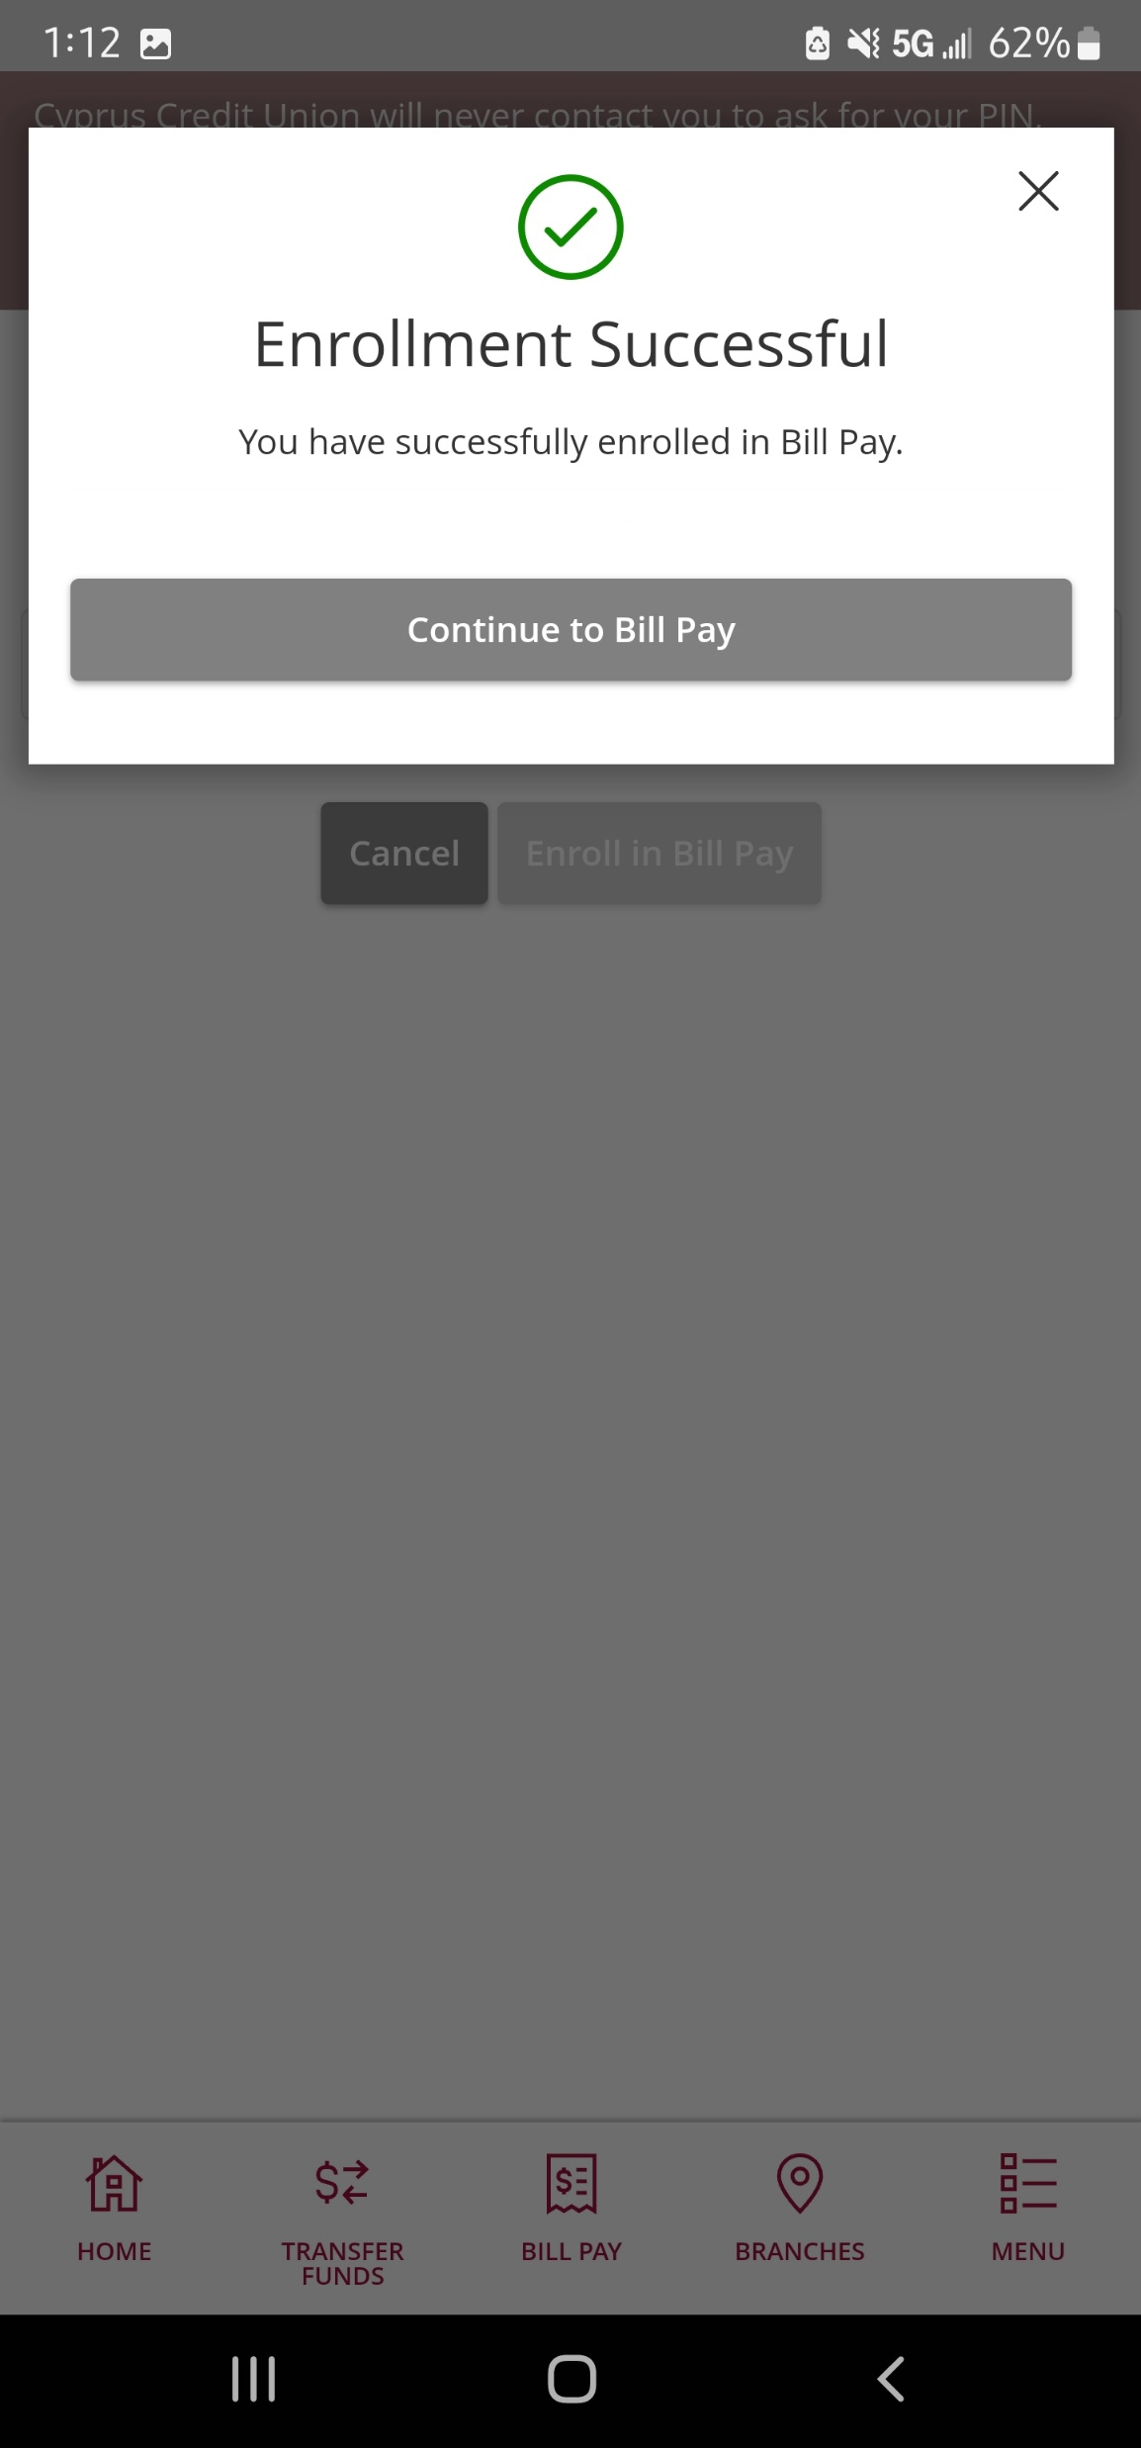
Enrolling in Bill Pay
1. You will need to have the member log into Home Banking and click on either “Bill Pay” at the bottom of the app or go to Menu > Transactions > Bill Payment. You will see a screen that looks like the image to the left.
2. The member will then need to select the account that they would like to enroll. Please keep in mind that the savings may appear as an option but if you attempt to enroll with it, it will give you an error. Always have them choose a checking account.
3. After they choose that, have the member hit “Enroll in Bill Pay”.
4. A pop up that says “Enrollment Successful” should appear and then viola! They are enrolled!

Slide 6
Adding a Payee!
A “payee” is the person or company that a member is trying to pay. For example: If a member is trying to pay their internet bill, the “payee” would be Comcast.

Slide 7
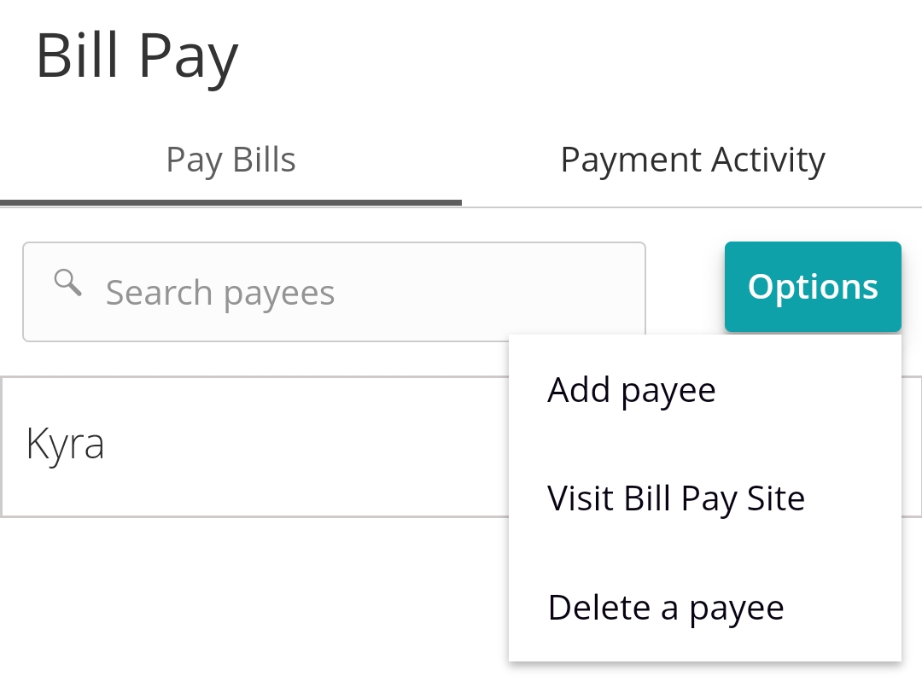
Adding a Payee Page 1
The member can add a payee two ways: on Home Banking, or on the Bill Pay site. We recommend going to the Bill Pay site as it is easier to use and has hundreds of popular payees with most of the required information already filled out.
1. To do this, the member will need to open the Bill Payment tab once more in Home Banking.
2. Then the member will need to click on the gray “Options” button towards the top right-hand side of the screen.
3. Then have them click “Visit Bill Pay Site”.

Slide 8
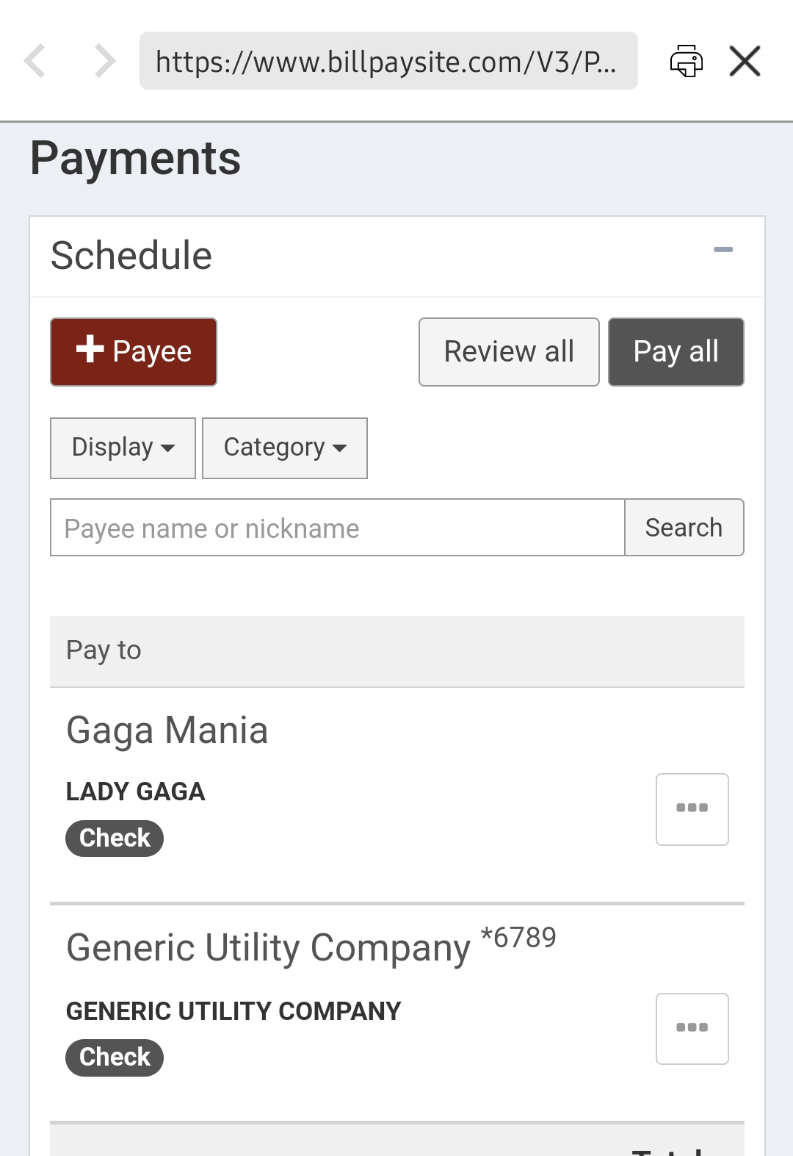
Adding a Payee Page 2
4. Once the member is at the Bill Pay Site, they should see the following screen.
If they don’t have any or need to set up a new one, you will want to have the member click on the red “+Payee” button.
If the member already has payees set up, they should appear here under the “Pay to” section.

Slide 9
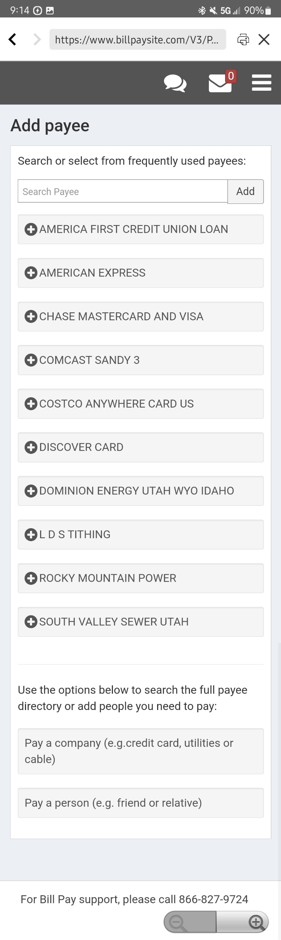
Adding a Payee Page 3
5. On the “Add Payee” screen (as seen to the right), the member can search for frequently used payees (such as Comcast, Rocky Mountain Power, and many more).
We are going to go through examples of each of these, but we are going to talk about the frequently used payees' section first.
6. They can also choose the “Pay a company” option to set up a company as a payee that they aren’t able to find in the frequently used payee section.
7. If they would like to send a payment to a person, such as a friend or relative, they can set that up here.

Slide 10
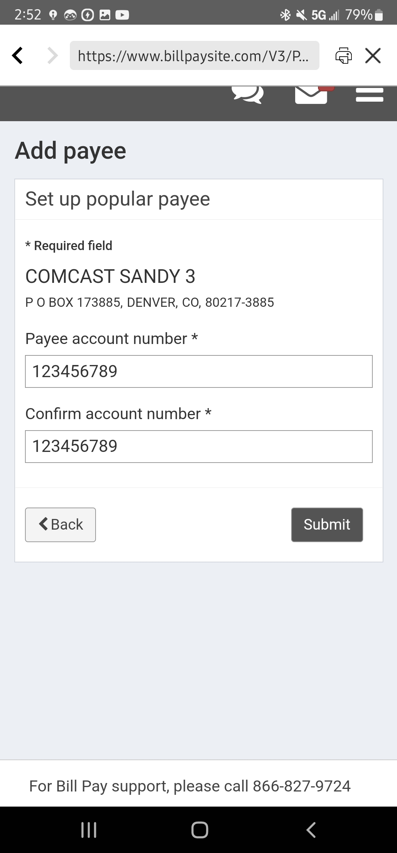
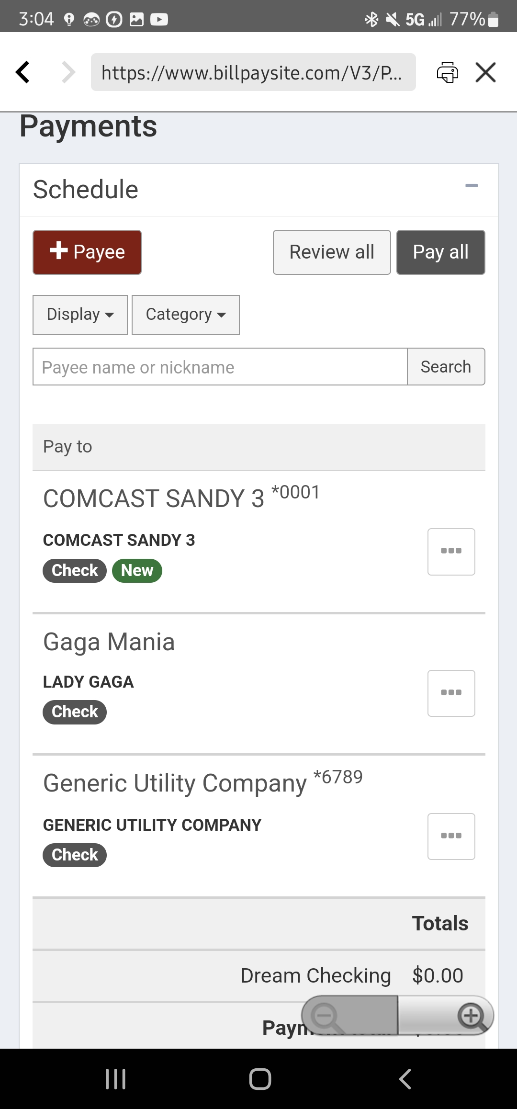
Adding a Payee - Frequently Used
3. In some cases, nothing else is required and the payee will immediately be available to send payments to. However, there are some cases that it will ask for an address. The next page will go over that.
1. Let’s say the member needs to pay Comcast. They can choose the “Comcast” option in the frequently used payee's section.
2. Once they click on this, it will ask them to put in the account number that it needs to be sent to (the member will need to get this from the payee if they don’t have it).

Slide 11
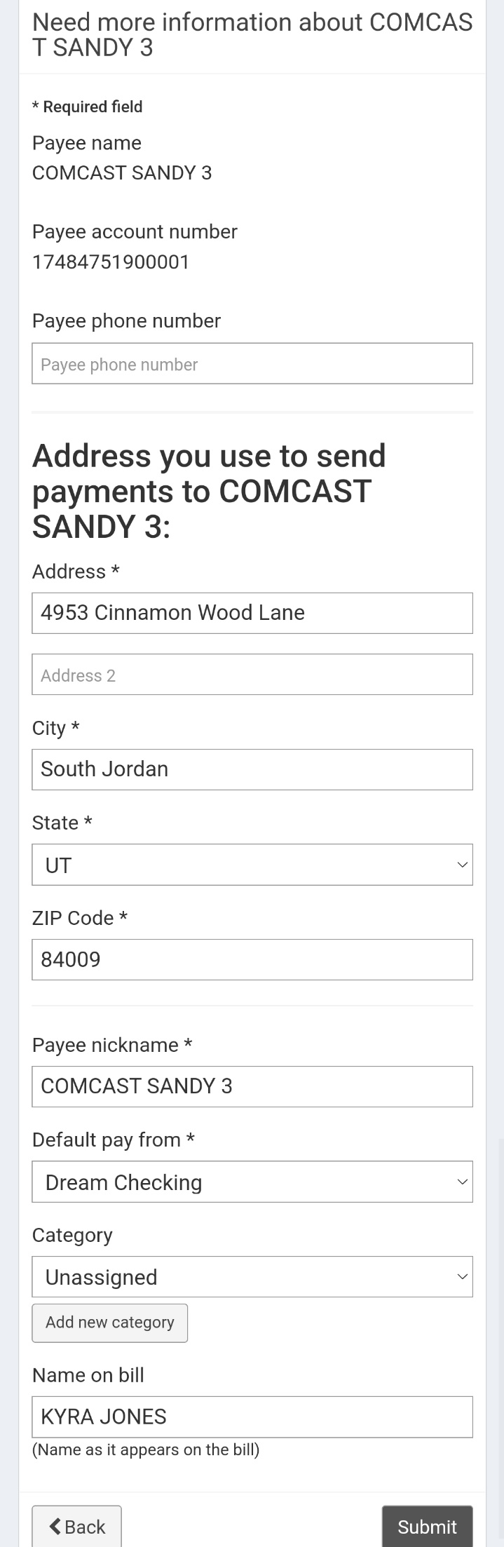
Adding a Payee - Frequently Used
4. Let’s say that after the member hit submit after entering the account number, this page shows up. The member will need to enter the mailing address of Comcast (where they want to send the payments to). Please keep in mind that these payments WILL be sent as a physical check, not electronically.
5. After they hit “Submit” the member should be able to see the payee on the main “Payments” screen.

Slide 12
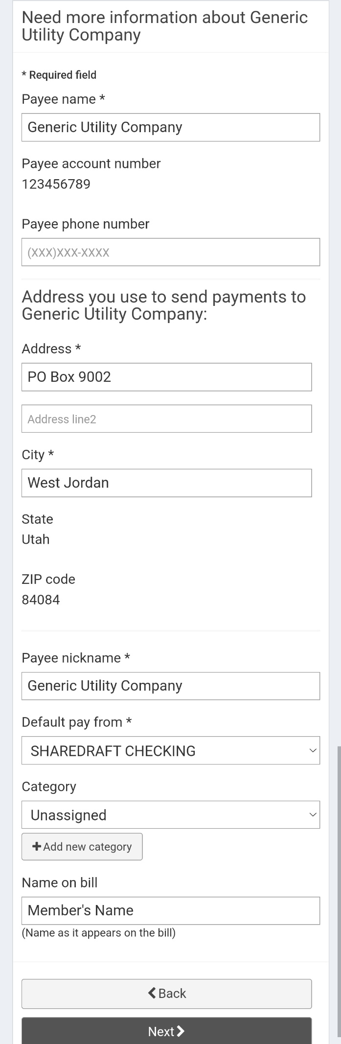
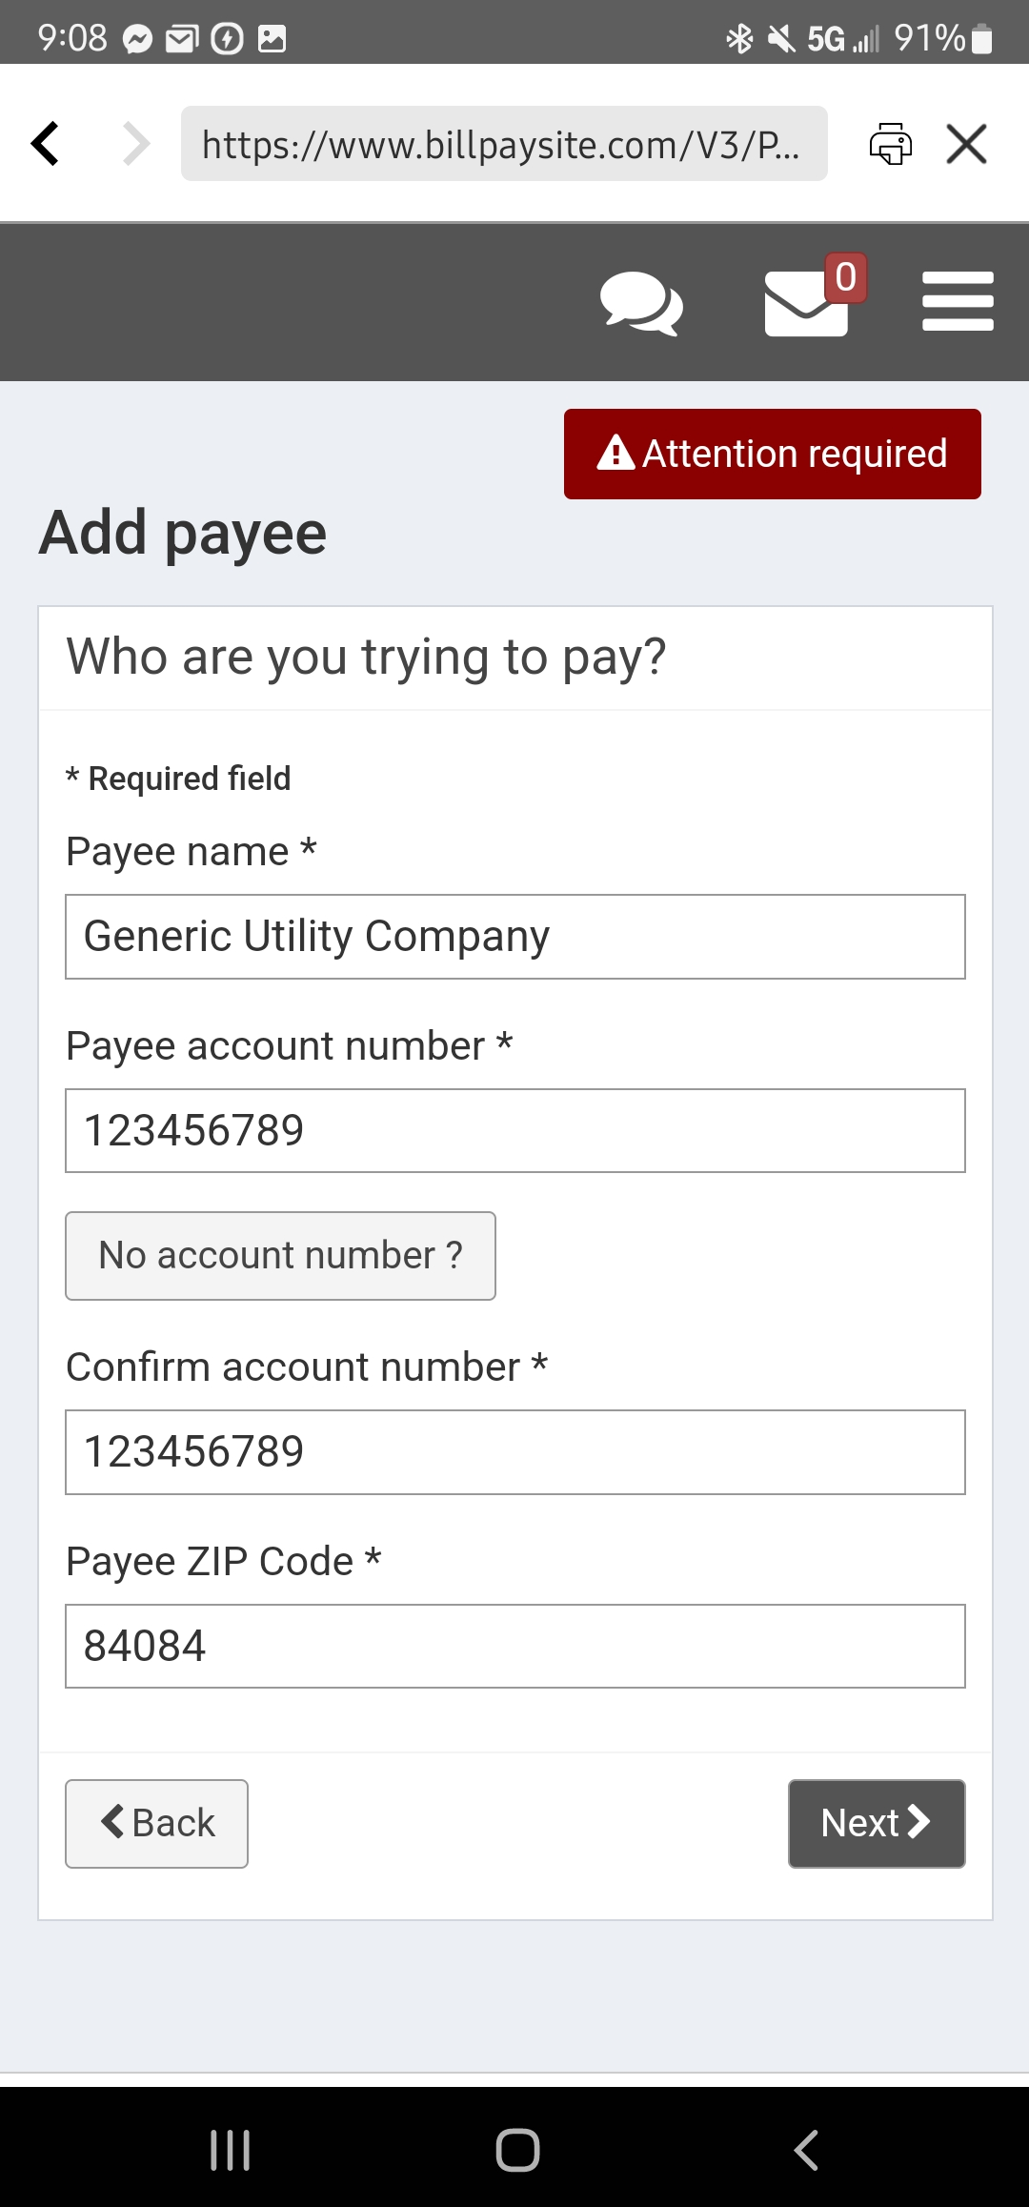
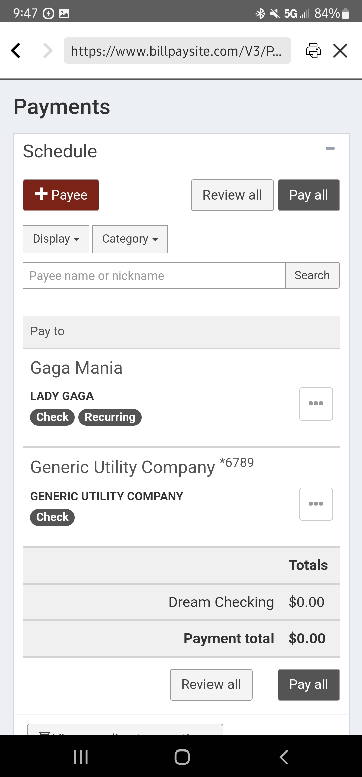
Adding a Payee – Company
3. After they hit submit, this page will show up and the member will need to enter the mailing address of Generic Utility Company (where they want to send the payments to).
1. If the member needs to pay a business that isn’t listed as a frequently used payee they will want to use this option. On the “Add Payee” page, you will want to direct the member towards the bottom of the screen and click the “Pay a Company” option.
4. After they hit “Next” the member should be able to see the payee on the main “Payments” screen.
2. Once they click on this, it will ask them to put in the name of the company, the account number that it needs to be sent to (the member will need to get this from the payee if they don’t have it) and the zip code.

Slide 13
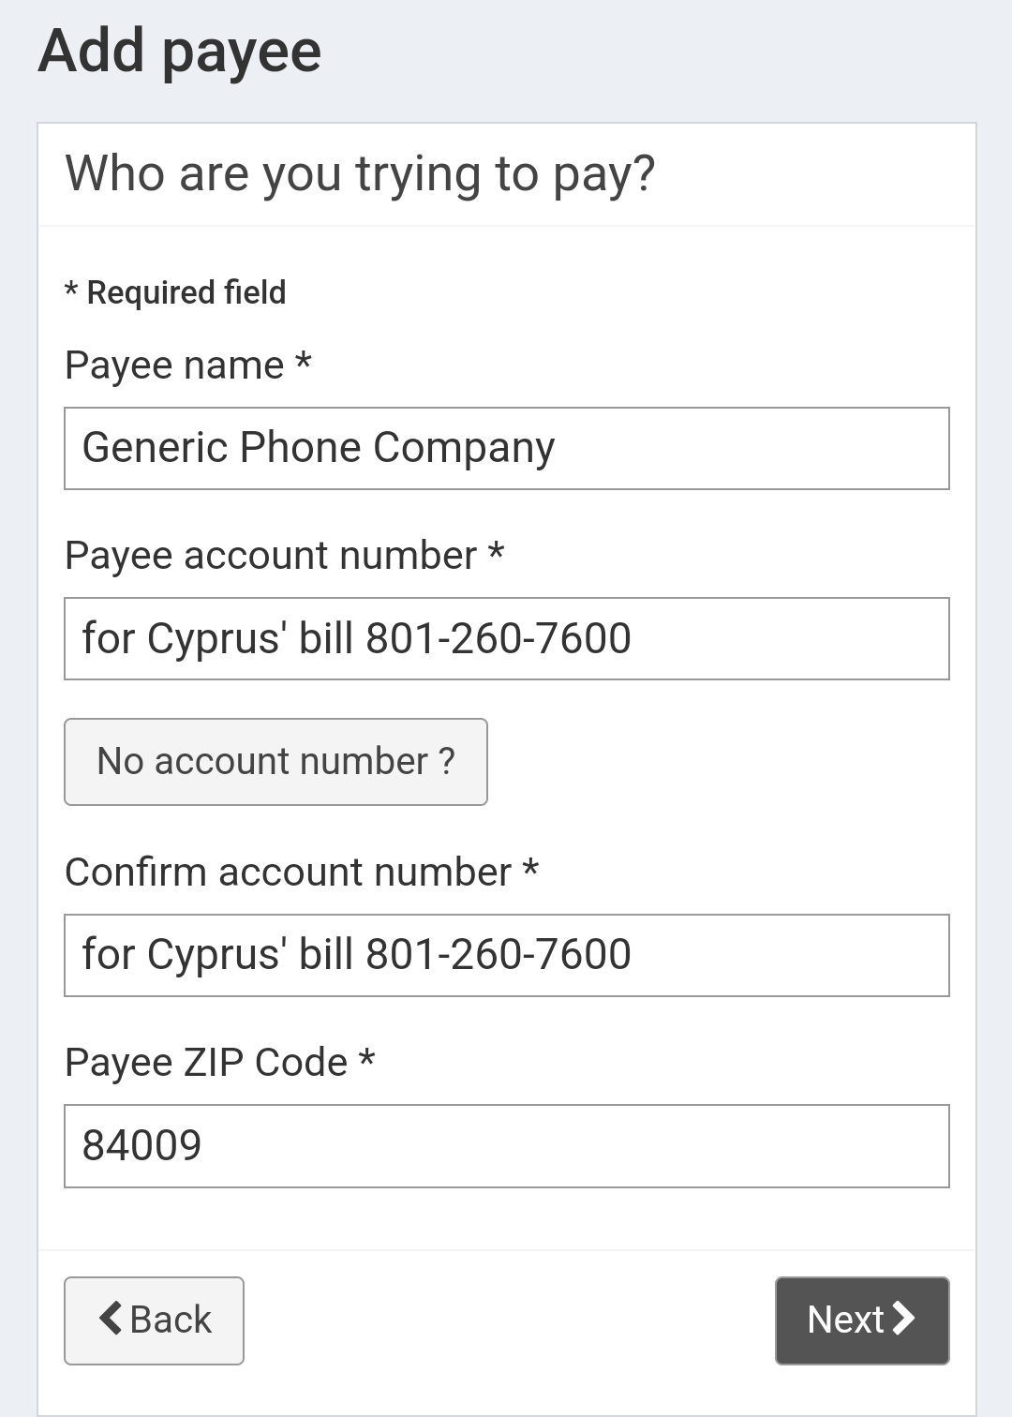
Adding a Payee – Unknown Account Number
If for some reason the member doesn’t have the account number for the place they are trying to pay (such as they don’t accept electronic payments) then the member can put any sort of further identifying information in the “account number” fields.
For example: Let’s say you are trying to pay your phone bill, you could provide the name on the bill (in this example, Cyprus) and the phone number linked to the account (801-260-7600). Please make sure the member knows that these payments will ONLY be sent as physical checks!

Slide 14
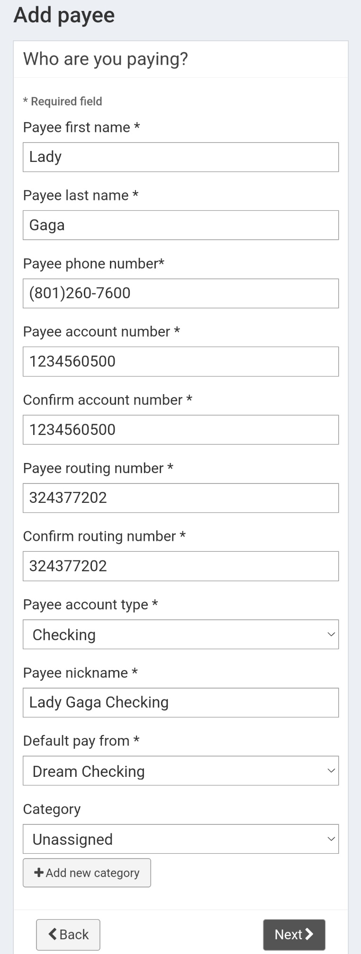
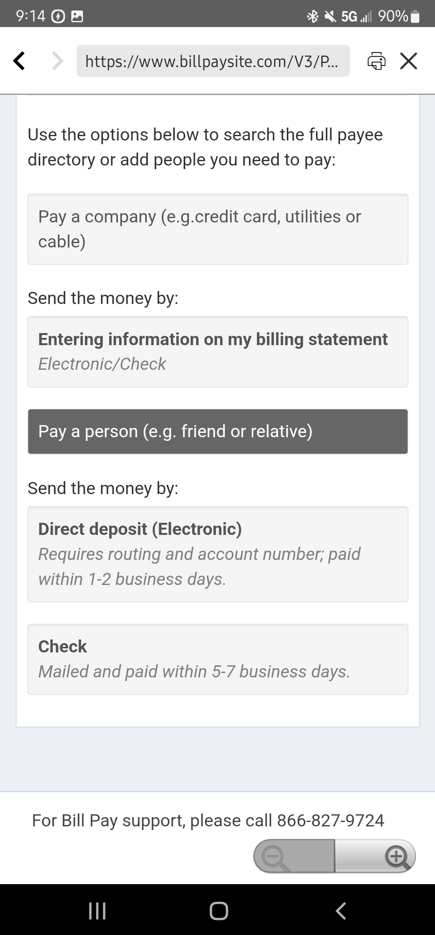
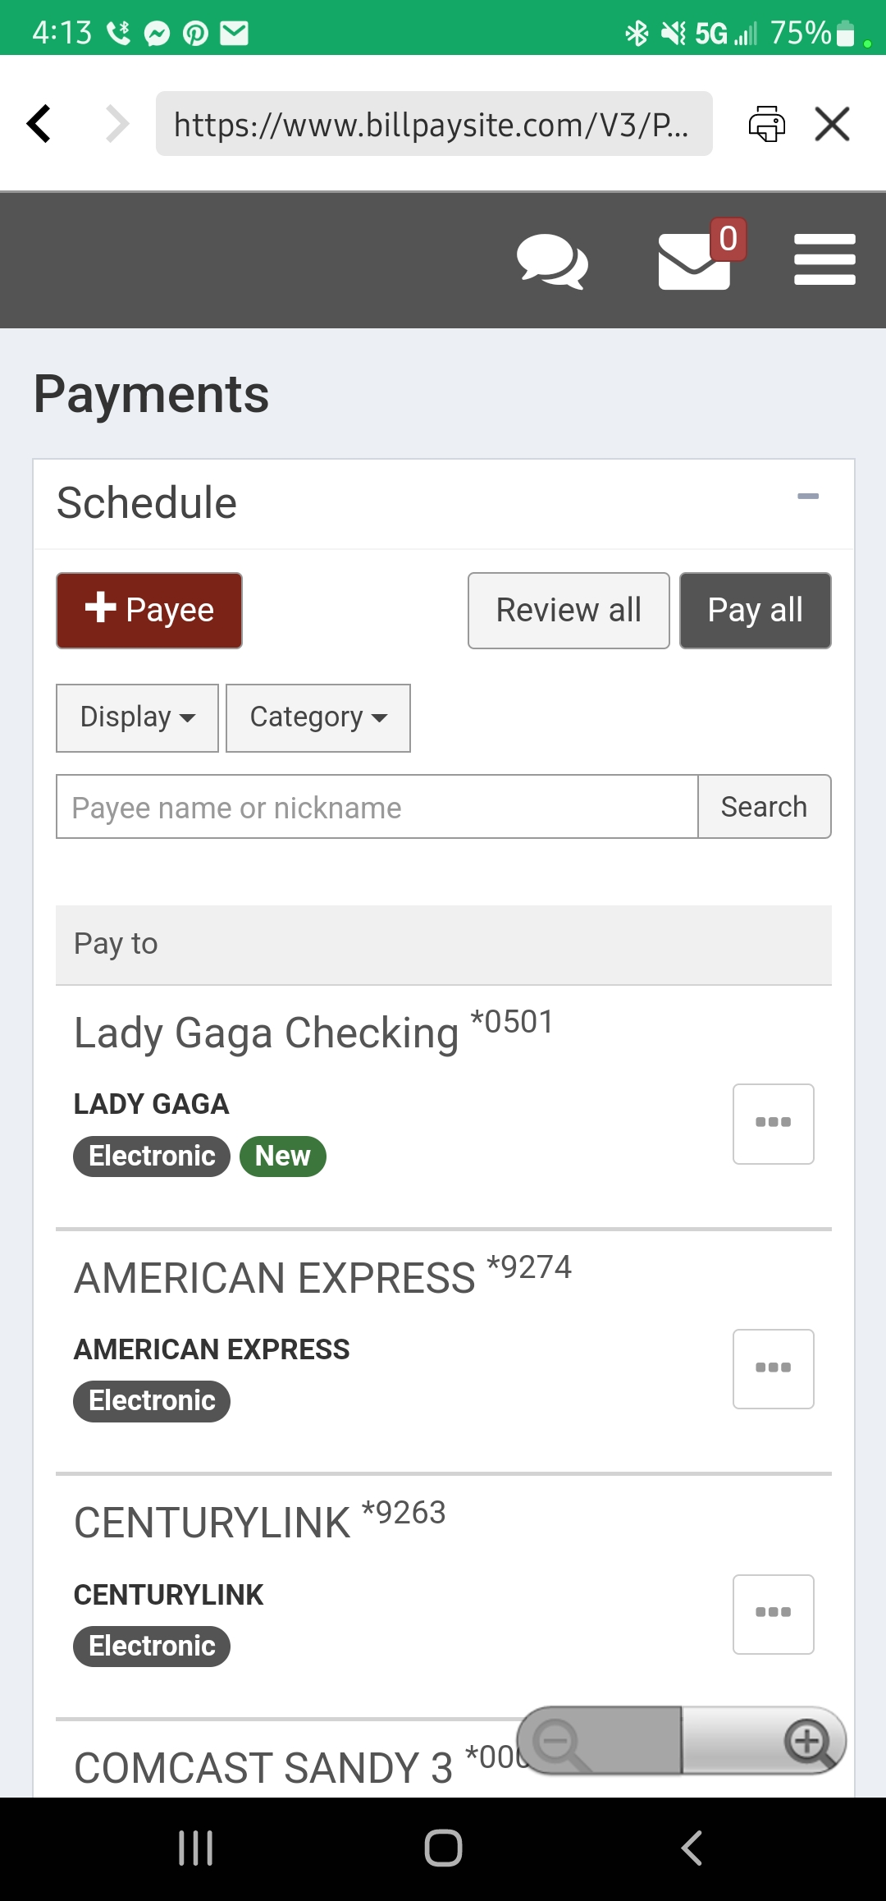
Adding a Payee – Individual Electronic
3. After they select that option, this page will show up and the member will need to enter the name, phone number, account type, and account/routing number of where they want to send the payment. They will also have to add a payee nickname.
1. Let’s say the member needs to pay an individual such as a family member or friend. On the “Add Payee” page, you will want to direct the member towards the bottom of the screen and click the “Pay a Person” option.
4. After they hit “Next” the member should be able to see the payee on the main “Payments” screen.
2. This should ask the member to specify if it’s to be set up for electronic deposit or via check. For this example, let’s do the Direct Deposit option.

Slide 15
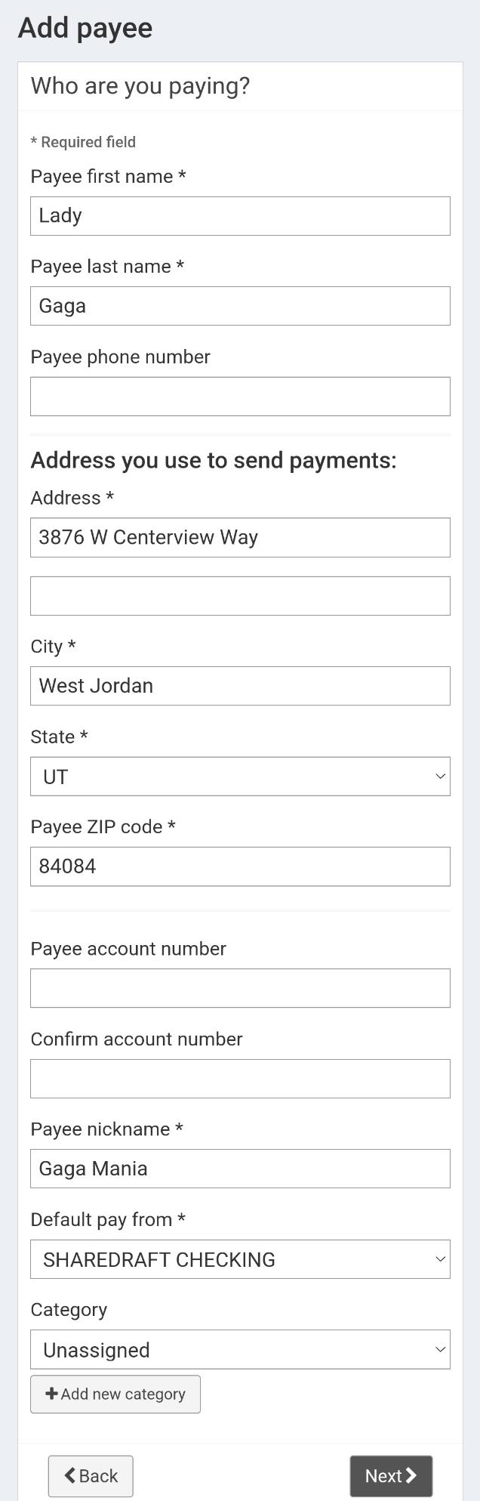
Adding a Payee – Individual Check
1. Now let’s back up and say that we want to set up an individual to pay via check. The member will need to choose the “Pay a person” option and then choose the “Check” option.
3. After they hit “Next” the member should be able to see the payee on the main “Payments” screen.
2. After they click that option, this page will show up and the member will need to enter the payee’s name, mailing address (where they want to send the payments to), as well as add a nickname for the payee. The account number is optional.

Slide 16
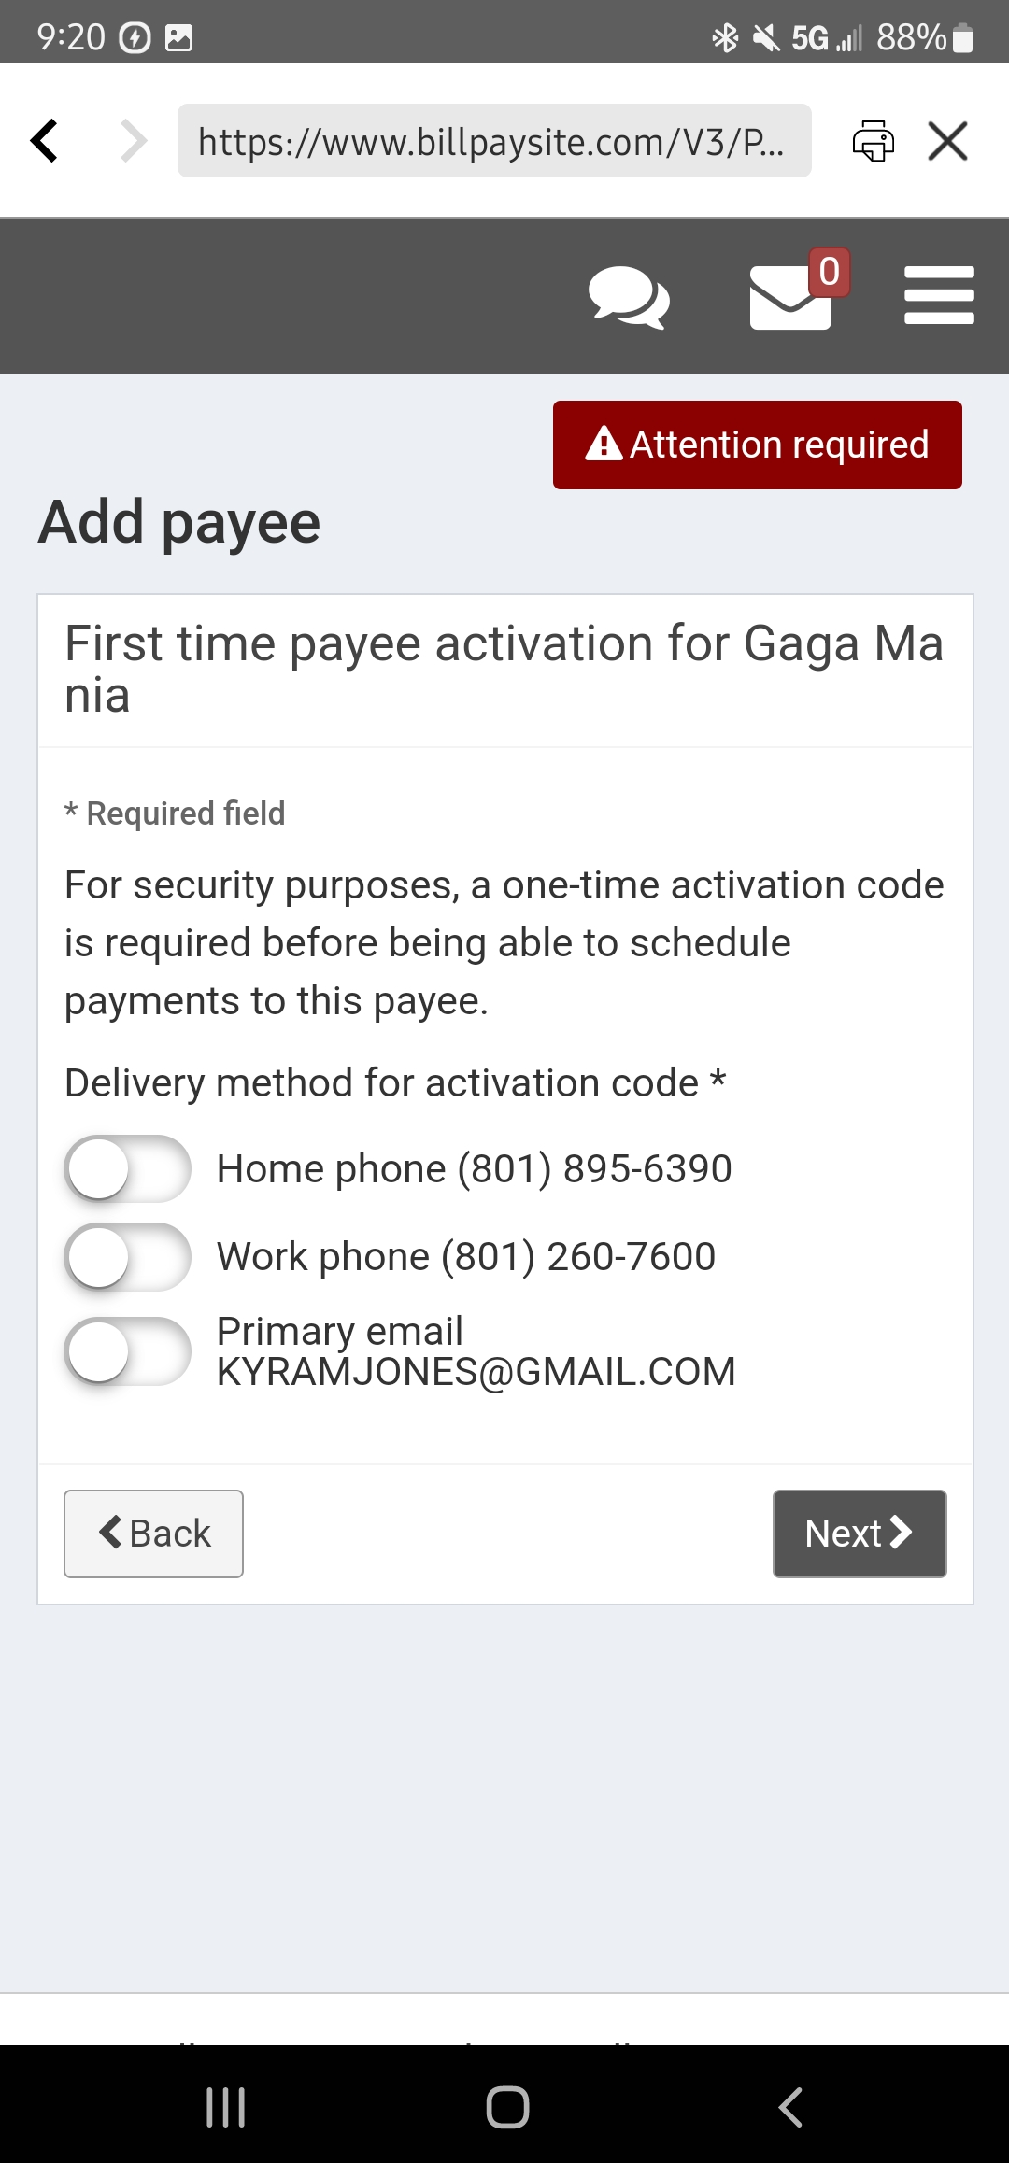
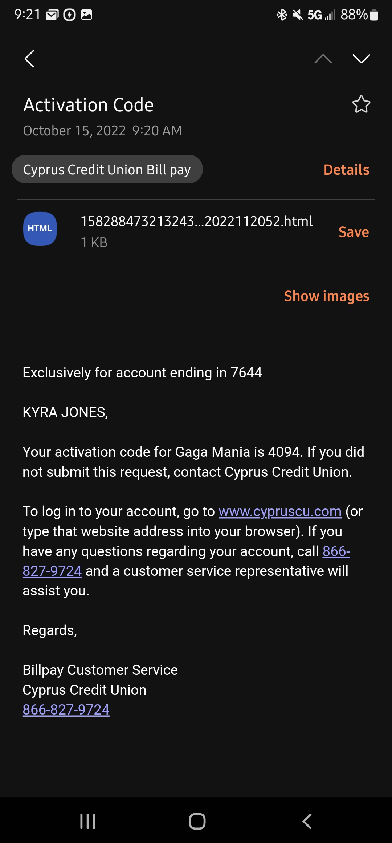
Adding a Payee – Verification
Occasionally after a member has added a payee to their Bill Pay, they might get a screen that looks like this.
If they select the email option, they should get an email similar to the email below with the code.
Once they have entered the secure access code, the member should be able to see the payee on the main “Payments” screen.
This is just a verification to make sure that it is in fact the member who is accessing the Bill Pay to add a payee. You will need to direct the member to select one of the options to receive the secure access code. If they select a phone, they should get a call.

Slide 17
Making a Payment
This section will talk about how to make a single payment on both the Home Banking end and the Bill Pay Site end.

Slide 18
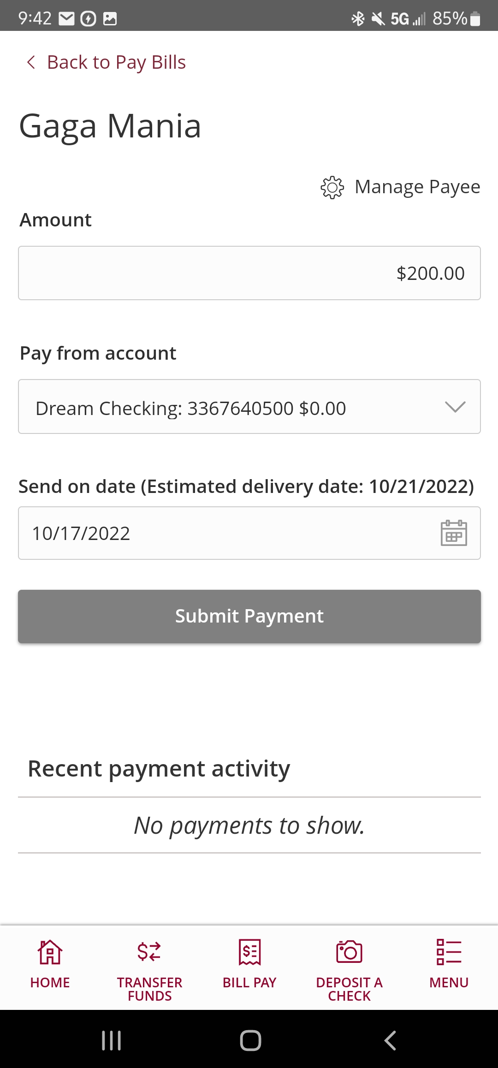
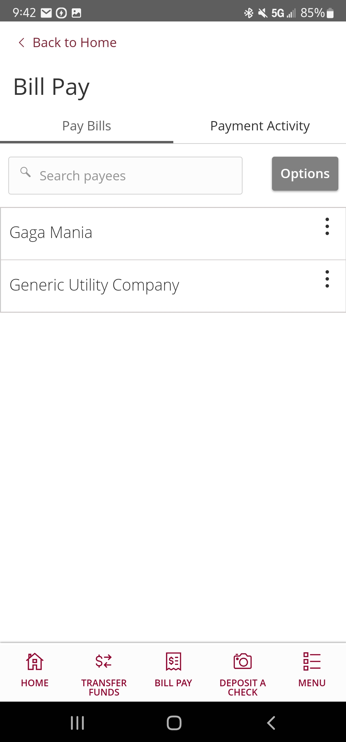
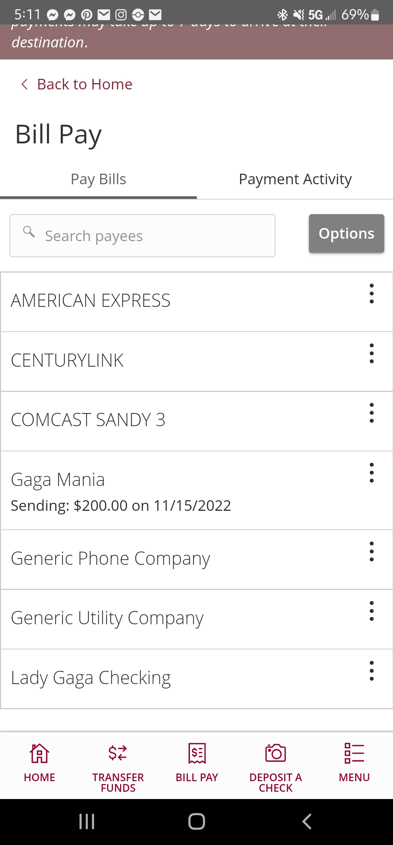
Making a Payment – Home Banking
2. The member should be taken to a page that looks similar to the picture on the right. Here they are going to put the amount they want to pay, choose the account from where they would like to pay (should just be the one unless they added a secondary which we will talk about later) and then choose when they want it to send. In this example we are sending $200 on 10/17/2022.
Now that we have successfully set up a payee, now comes the fun part: making the payment! Just like adding the payee, the member can either make the payment on Home Banking, or by visiting the Bill Pay Site. First, we are going to talk about doing it on Home Banking.
1. Once the member is at the Bill Pay page in Home Banking, they should be able to see all of their payees. Let’s go ahead and make a payment
3. Once the member goes back to the Bill Pay home page in Home Banking, the payment should show as such.

Slide 19
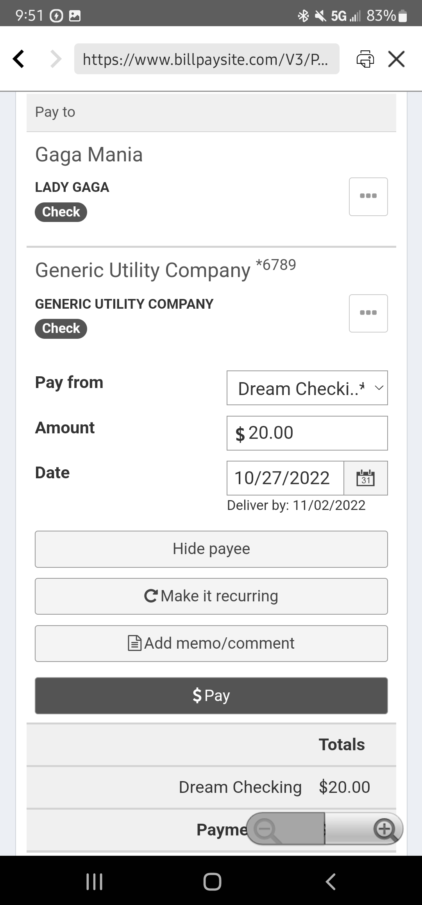
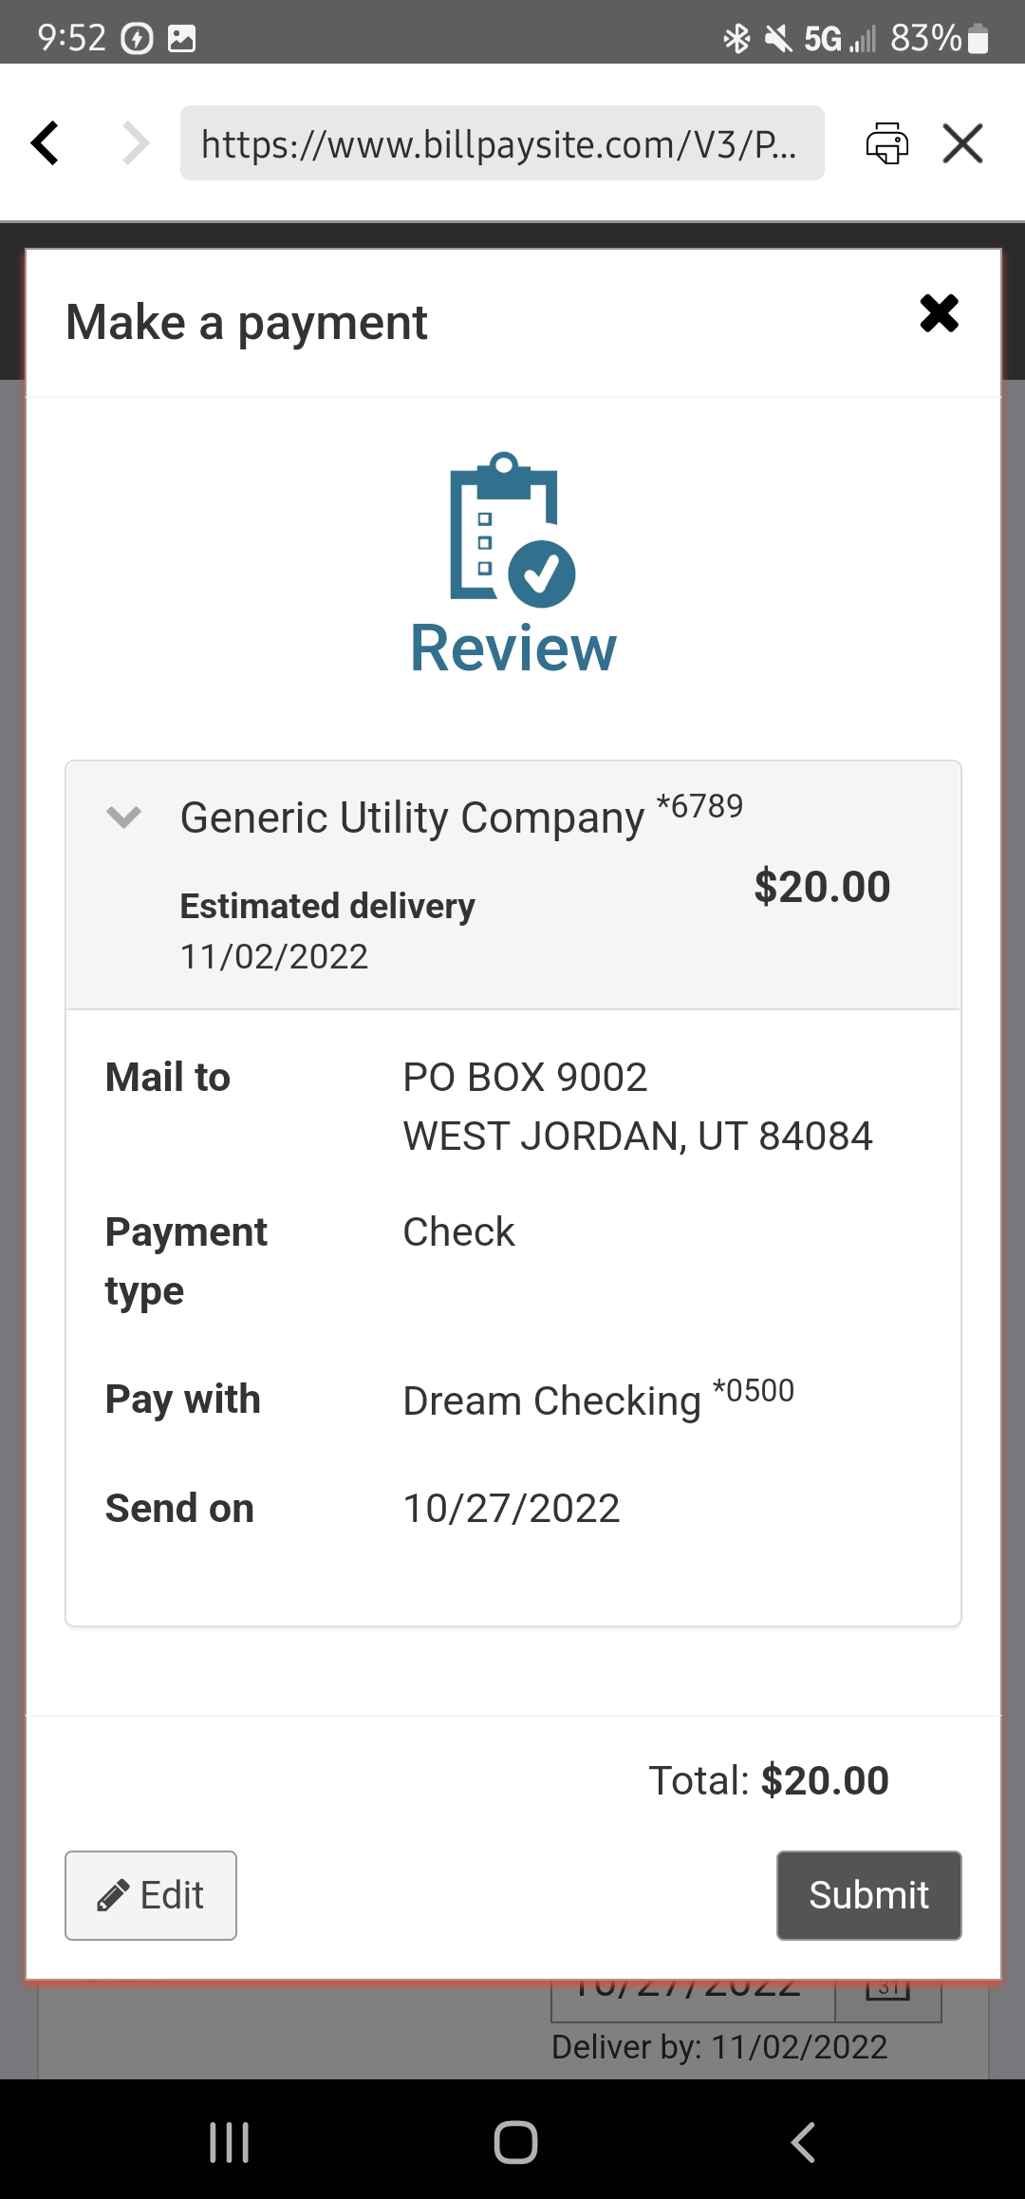
Making a Payment – Bill Pay Site
3. The following review pop up should appear and the member will want to review the payment details and then hit “Submit” and the payment is successfully set up!
1. To make a payment on the Bill Pay Site, the member will first need to click on the three vertical dots next to the payee they would like to pay. In this example we are going to pay Generic Utility Company.
2. It should expand to show some options like in the picture above. The member will need to put in the amount and when they want it to process and hit the gray “Pay” button at the bottom.

Slide 20
Editing a Payment
This section will talk about how to edit a single payment.

Slide 21
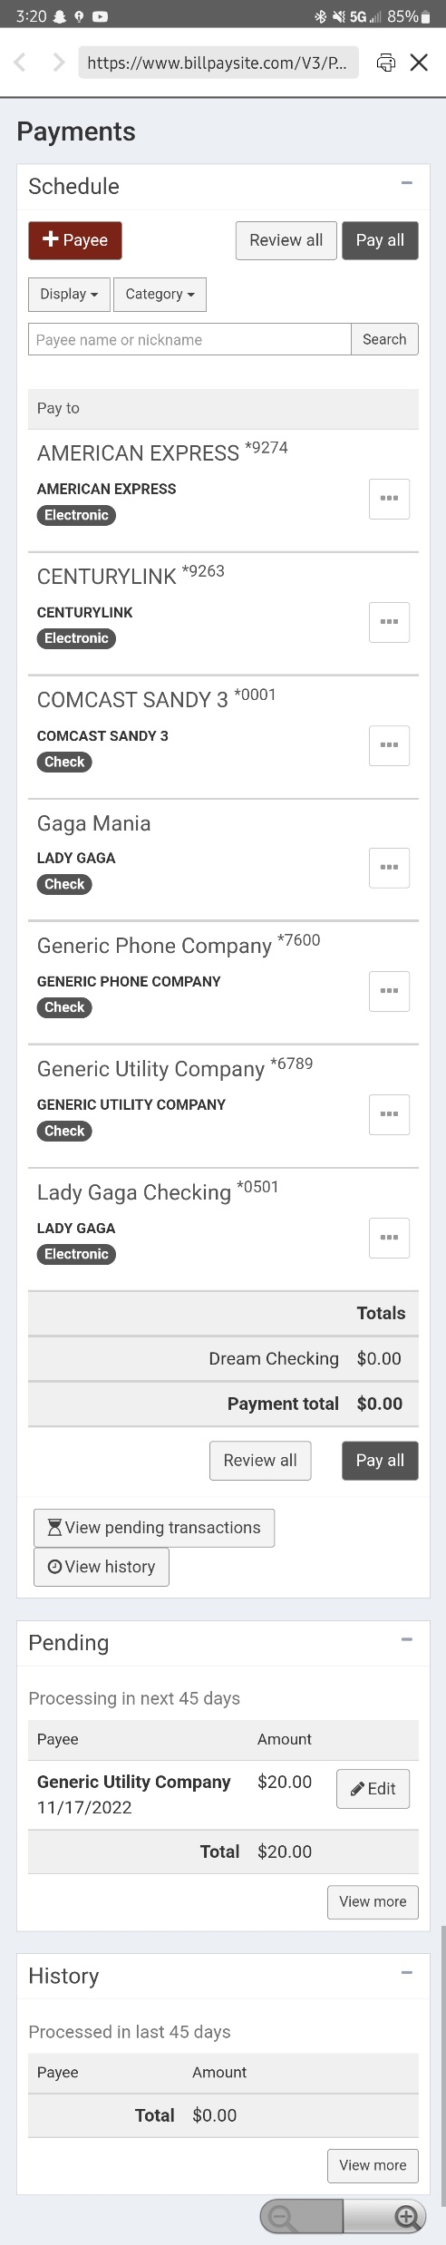
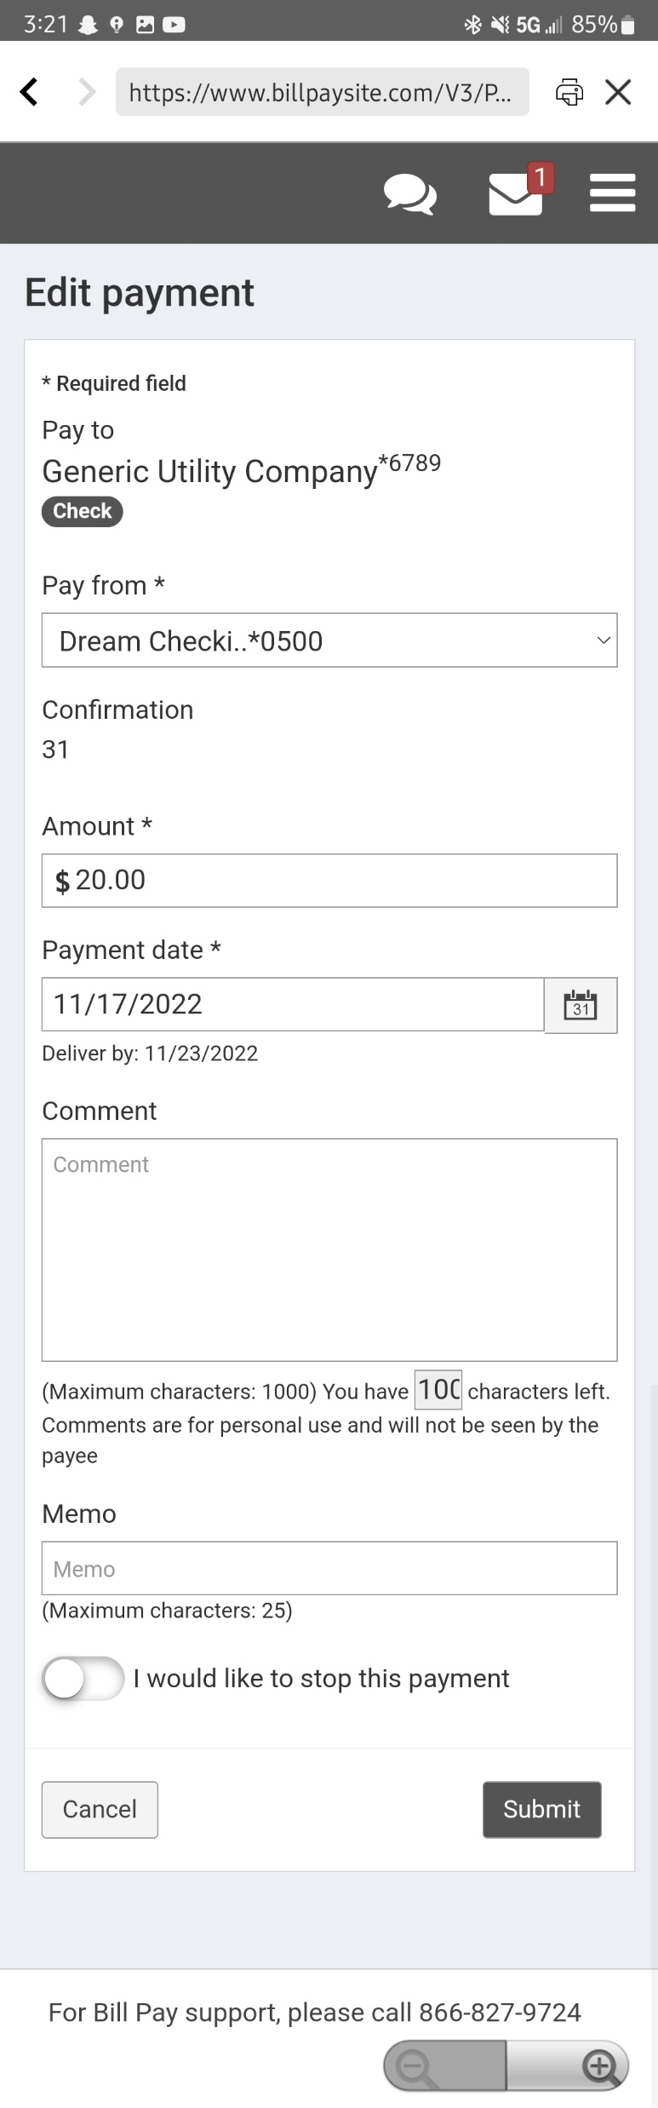
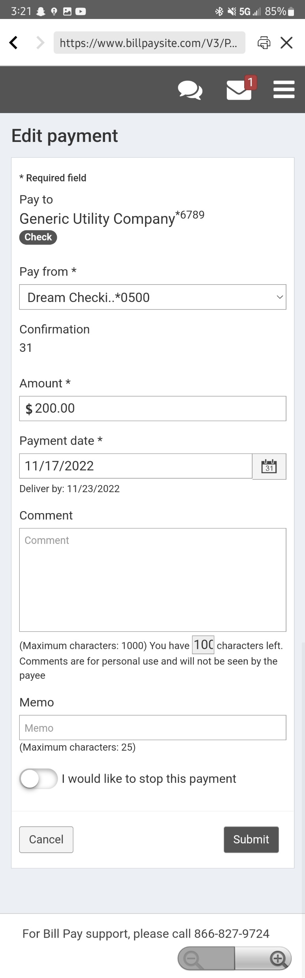
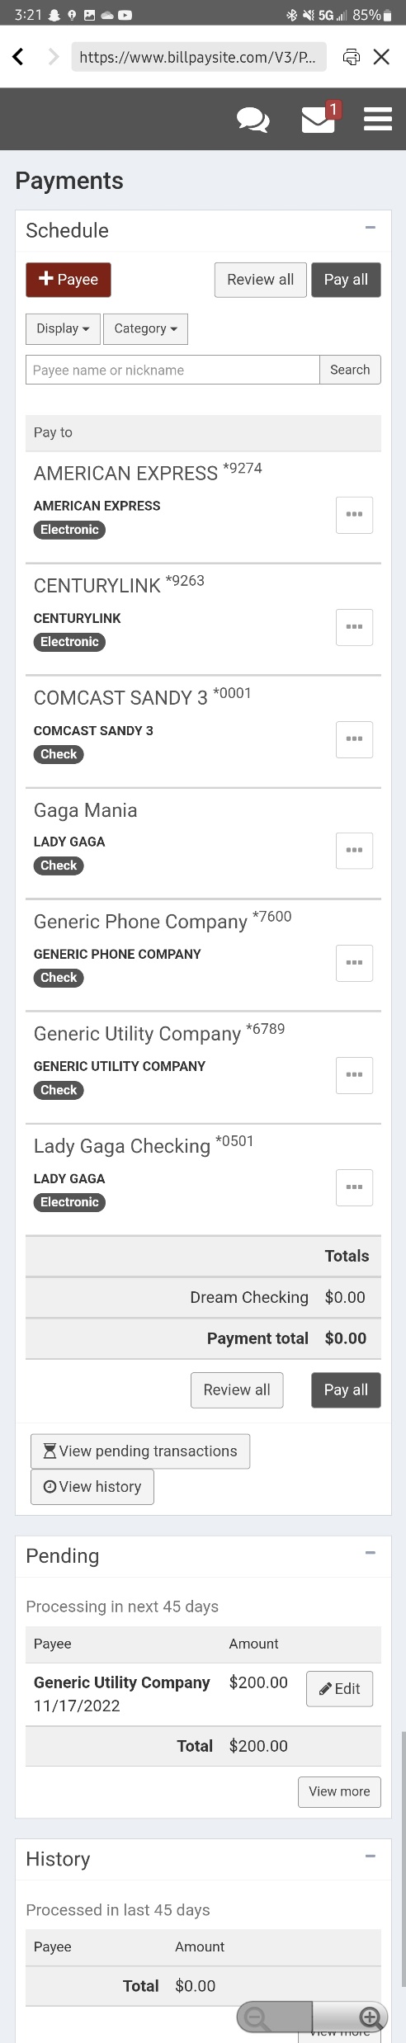
Editing Payment
3. A page similar to the one on the left should show up. Here, the member can make any changes they need. For this one, we are going to change the amount to $200.
1. To edit a payment, the member will need to go to the Bill Pay Site. On the main page, they will need to scroll down until they find a section labelled “Pending”. Here the next 45 days worth of payments will show up. As you can see in this example, a payment of $20 to Generic Utility Company is set to process on 11/17/2022.
4. Then, once the member hit’s “Submit” they should be able to go back to the main page and see the updated payment amount.
2. In this example, let’s say the member accidentally did $20 for the payment to Generic Utility Company but meant to do $200. The member will need to click the “Edit” button next to the transaction they are wanting to edit.

Slide 22
Setting up a Recurring Payment
This section will talk about how to set up a recurring payment which can only be done on the Bill Pay Site.

Slide 23
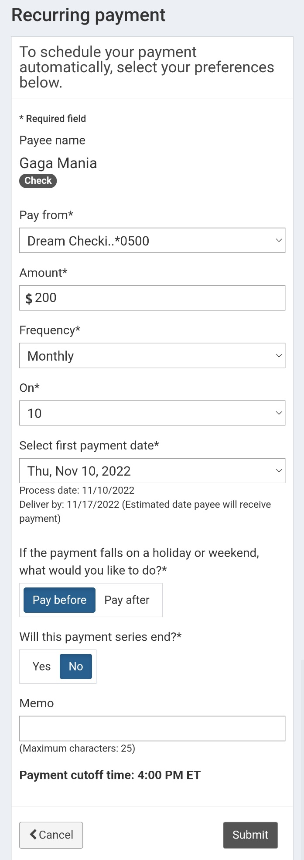
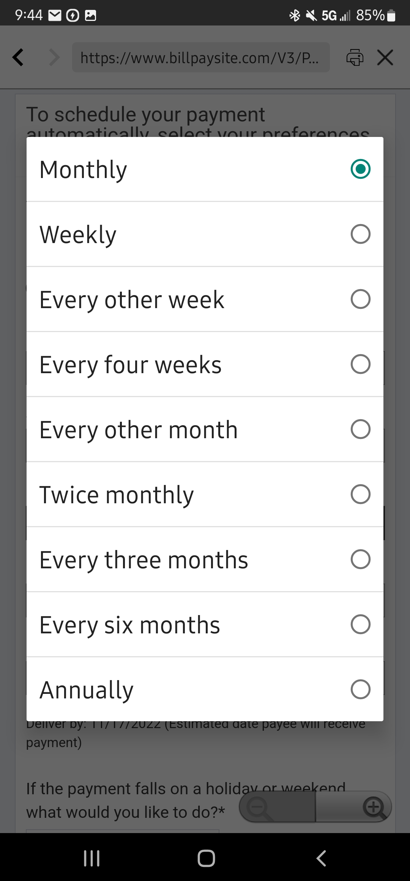
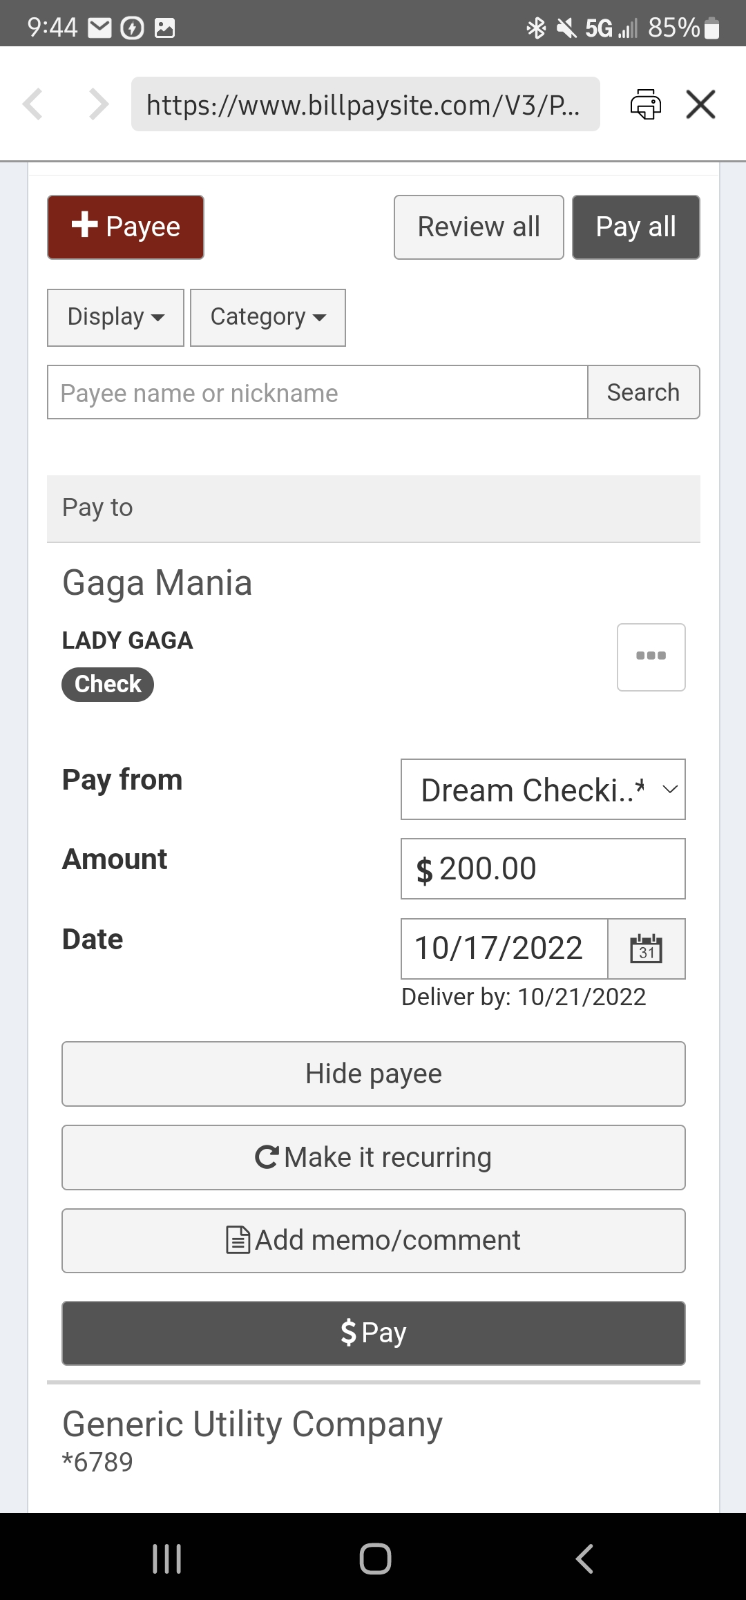
Set up Recurring Payment – Page 1
The frequency has the following options:
2. It should take the member to a page like this where they will fill in the required information.
1. To make a payment recurring on the Bill Pay Site, the process is the same as making a normal payment but instead of clicking “Pay” you will want to direct the member to click the “Make it recurring” button.
3. After they choose their frequency they will need to choose the first payment date and the recurring date(s) of the payments. They can choose any date of the month or the “Last Business Day” of the month.
4. If the member wants the recurring payment to end after a certain amount of time they will be prompted to choose the end date.

Slide 24
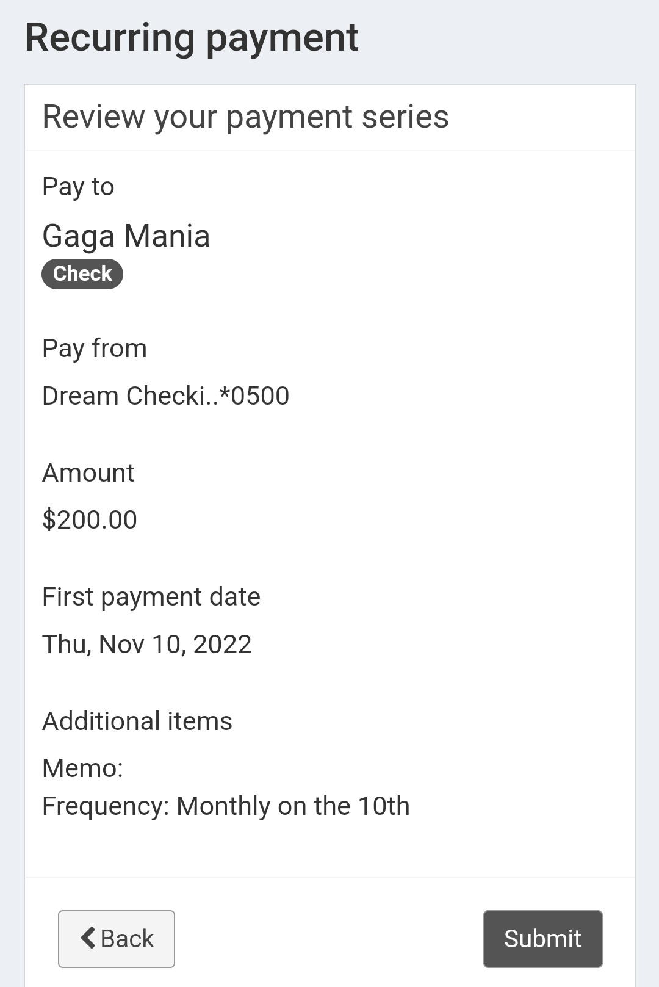
Set up Recurring Payment – Page 2
5. Once the member clicks “Submit”, they will need to review the payment series before hitting “Submit” once more.
6. After that, the payment is set up and the payee should have a gray bubble that says “recurring” to indicate the continual payments.

Slide 25
Editing a Recurring Payment
This section will talk about how to edit an existing ongoing payment.

Slide 26
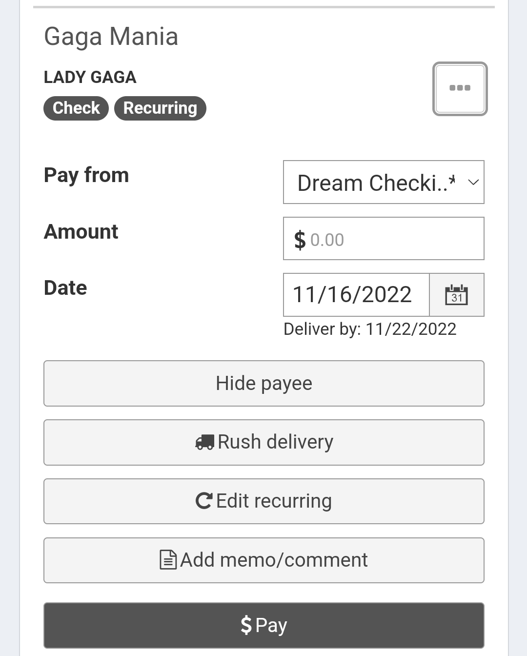
Edit Recurring Payment – Page 1
As discussed previously, the member can verify if they have recurring payments to a payee by looking at the main page and seeing the gray recurring bubble.
2. It should expand to show the following. The member will then need to click the “Edit Recurring” button.
1. To edit it, the member will first need to click on the three vertical dots next to the transaction name.

Slide 27
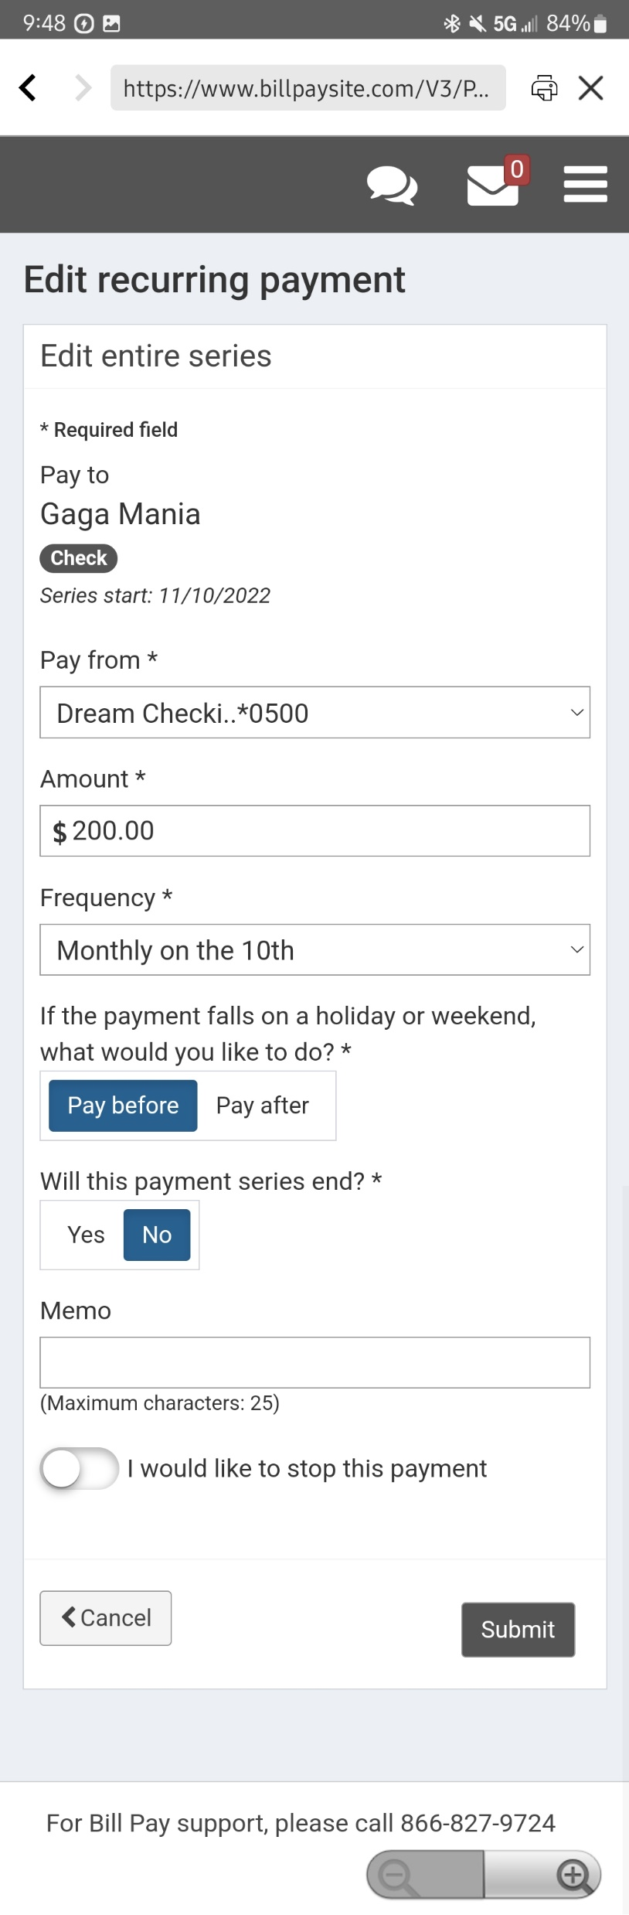
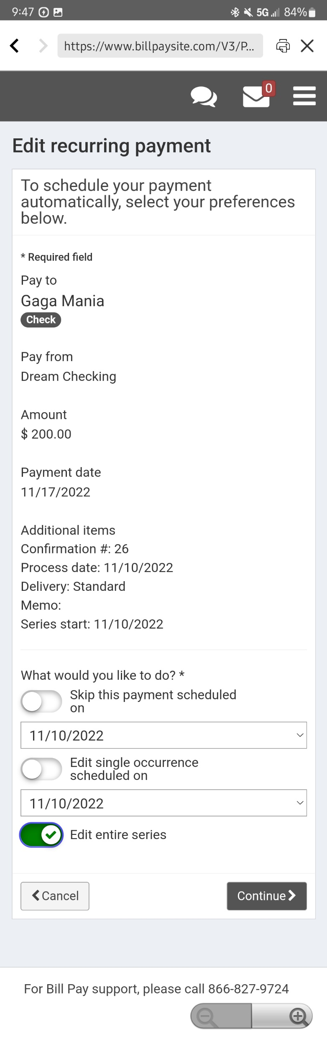
Edit Recurring Payment – Page 2
3. They should be redirected to the “Edit recurring payment” page where they will need to choose one of the following options:
4. On the next page, the member can make any required changes such as changing the dollar amount or frequency. Once the changes are made, they can hit “Submit” and the changes are made!
To skip a single payment,
Edit a single payment,
Or edit the whole series. For this example, we are going to edit the entire series.

Slide 28
Cancelling a Recurring Payment
This section will talk about how to stop an ongoing payment.

Slide 29
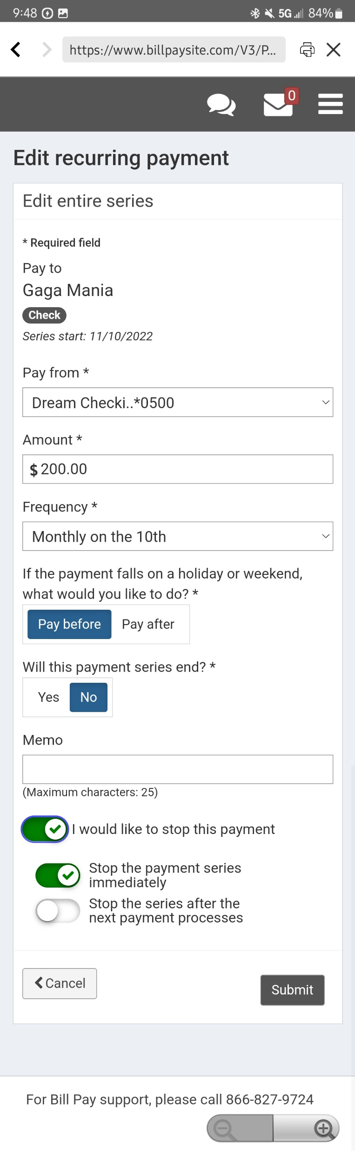
Cancelling Recurring Payment
1. To cancel a recurring payment, you will need to follow all the previous steps to edit a recurring series. Once you get to the “Edit Recurring Payment” page, you will just have to have the member click the “I would like to stop this payment” button.
2. The member will be given two choices: to stop the payment immediately or to stop it after the next payment processes.
3. After they have selected one of those options they just need to click on the “Submit” button and they should be good to go!

Slide 30
Cancelling a Single Payment
This section will talk about how to stop a single payment that is scheduled.

Slide 31
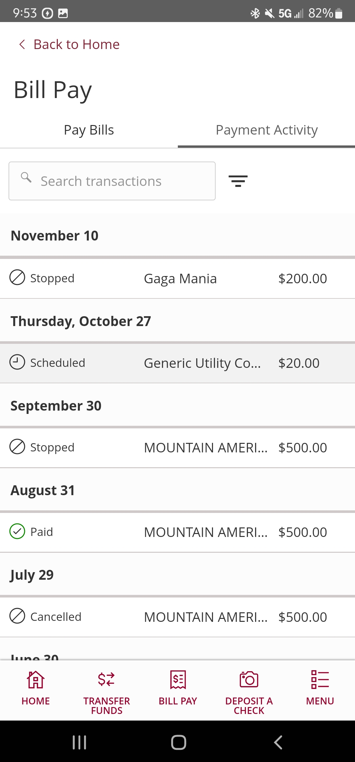
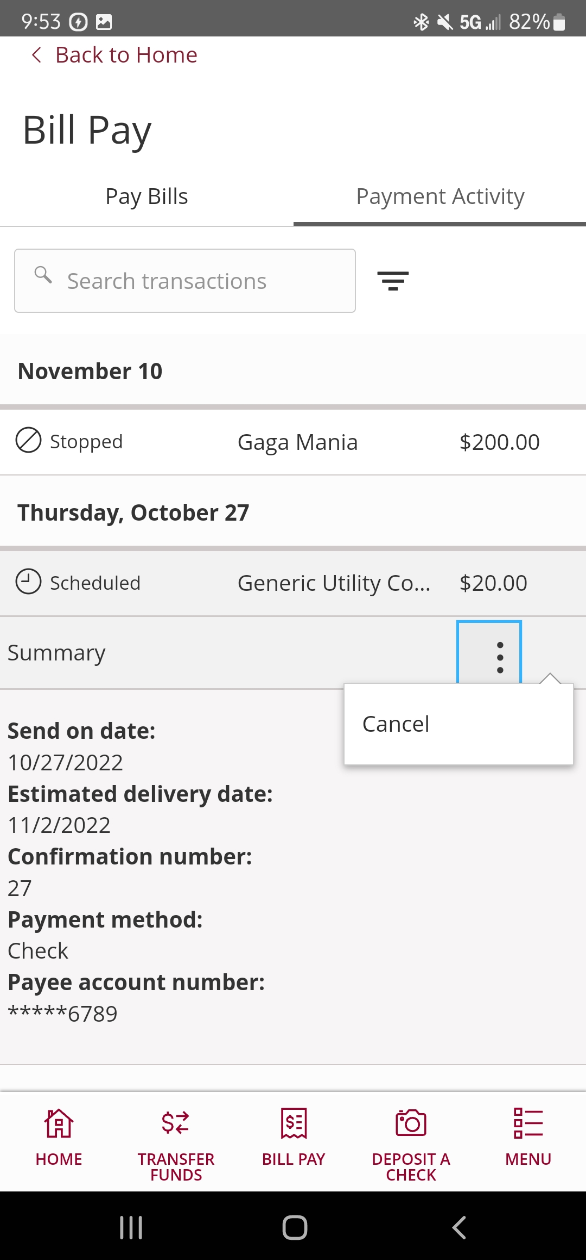
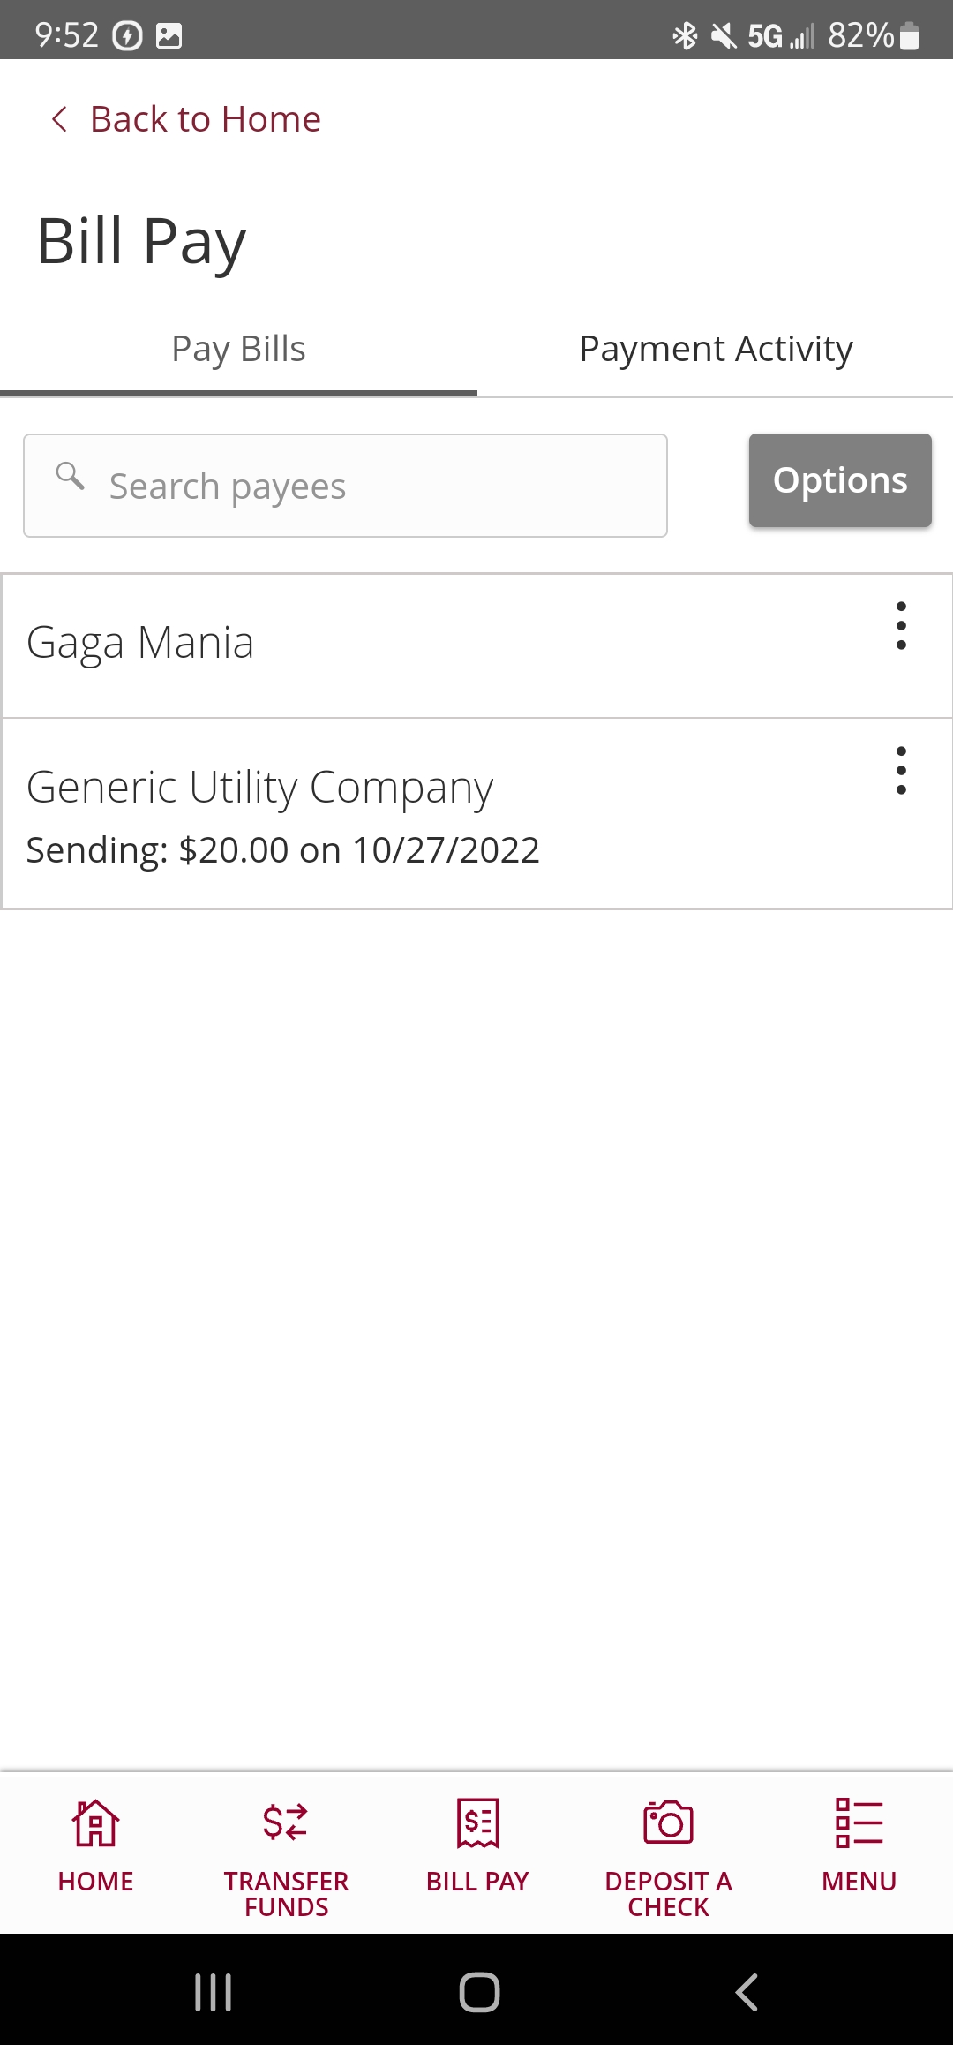
Cancelling Payment – Home Banking
3. When they do this, it will expand to show some information and three vertical dots will show. Have them click on that and click on the “Cancel” button.
The easiest way to cancel a single payment that is scheduled to be paid is to do so on Home Banking.
1. Once on the Bill Payment page, you will want to direct the member to the “Payment Activity” tab.
2. This should show all the recent activity on the member’s bill pay. The member will want to click on the “Scheduled” payment that they want to cancel.

Slide 32
Cancelling Payment – Bill Pay Site
1. To cancel a payment on the Bill Pay Site, you will have the member go to the “Pending” section and find the transaction they want to cancel. Direct them to click on the “Edit” button.
2. The “Edit payment” page should show up and at this point you would need to have the member click the “I would like to stop this payment”
3. The member will be given two choices: to stop the payment immediately or to stop it after the next payment processes.
4. After they have selected one of those options they just need to click on the “Submit” button and they should be good to go!

Slide 33
Adding a Second Account to Bill Pay
If the member has multiple checking accounts with us and wants to send Bill Pay’s from more then just the initial account that they enrolled in, they can add additional checking accounts. This will allow them to choose from which account they want to send payments from.

Slide 34
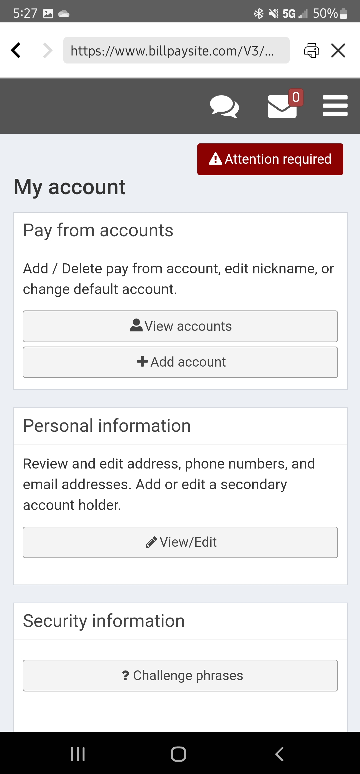
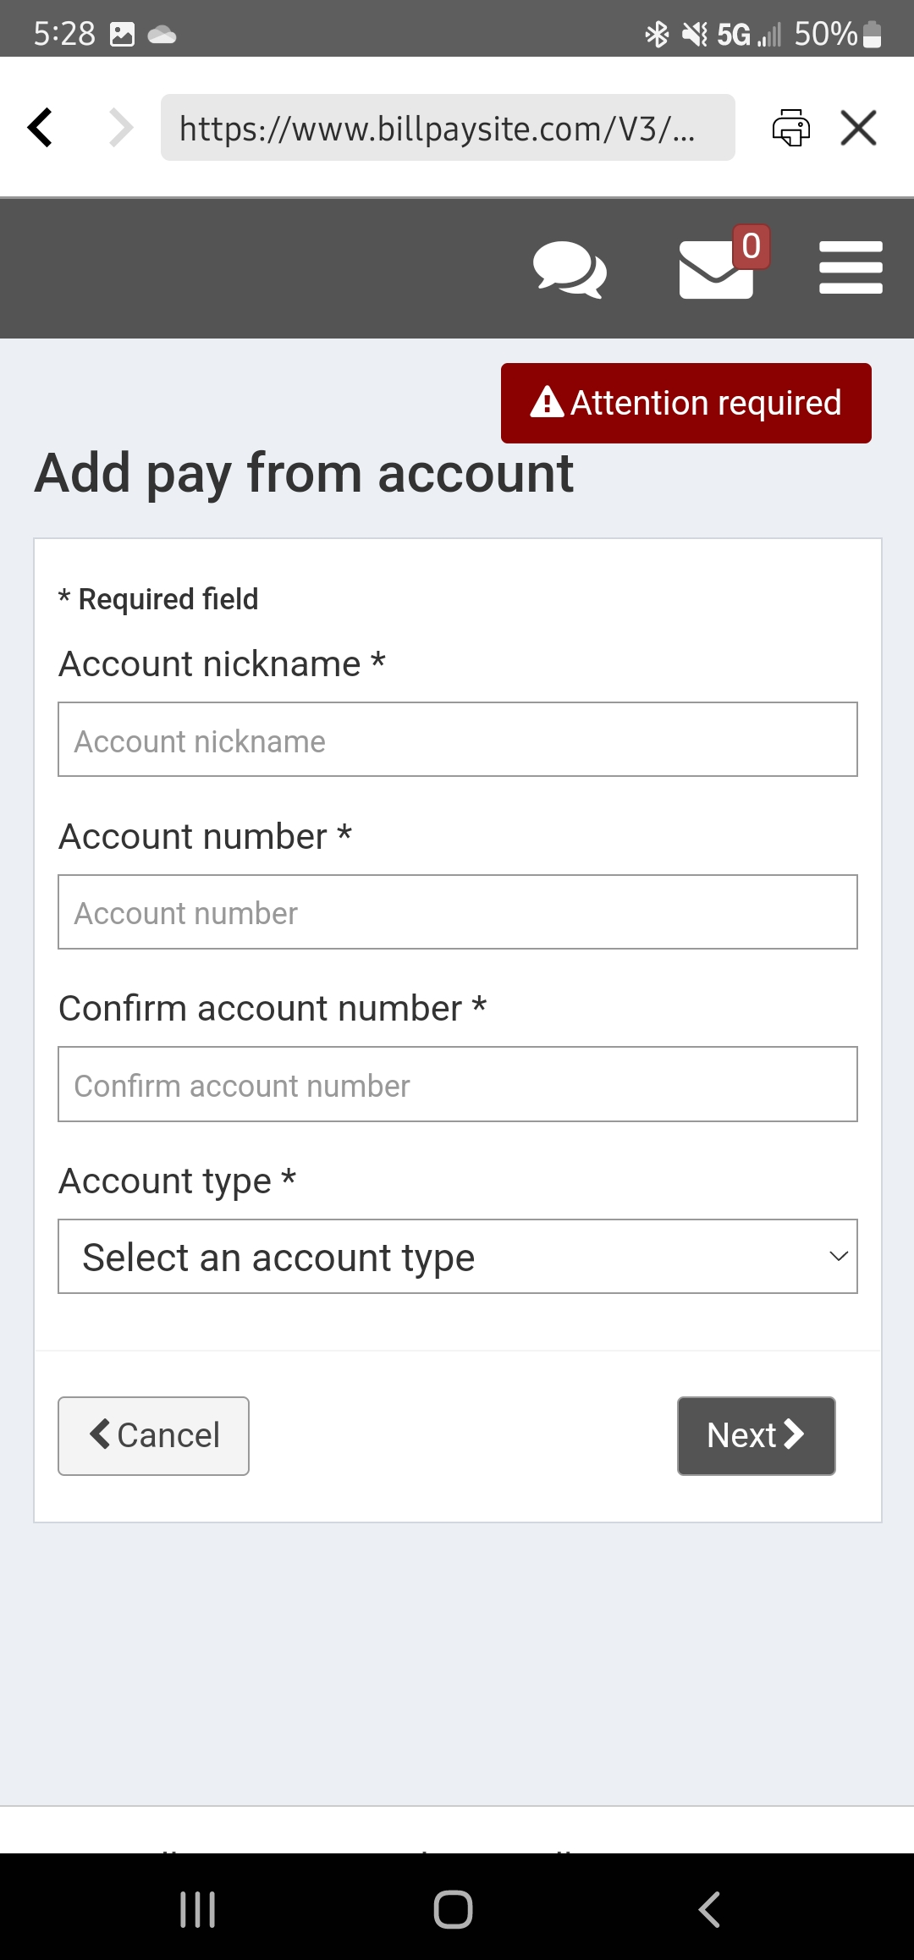
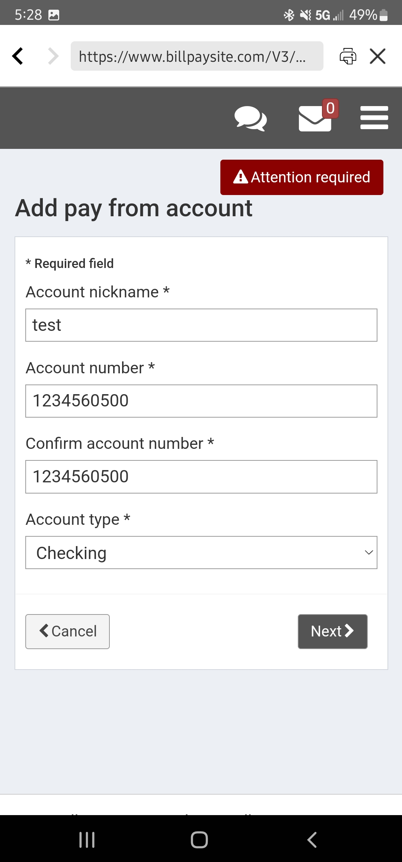
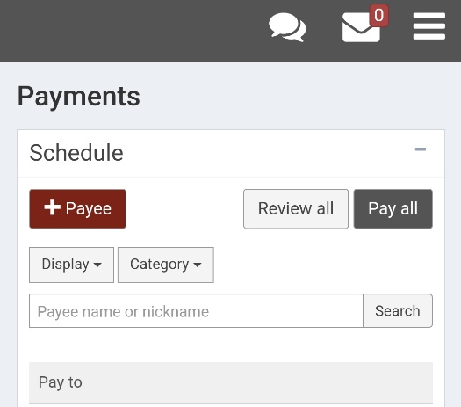
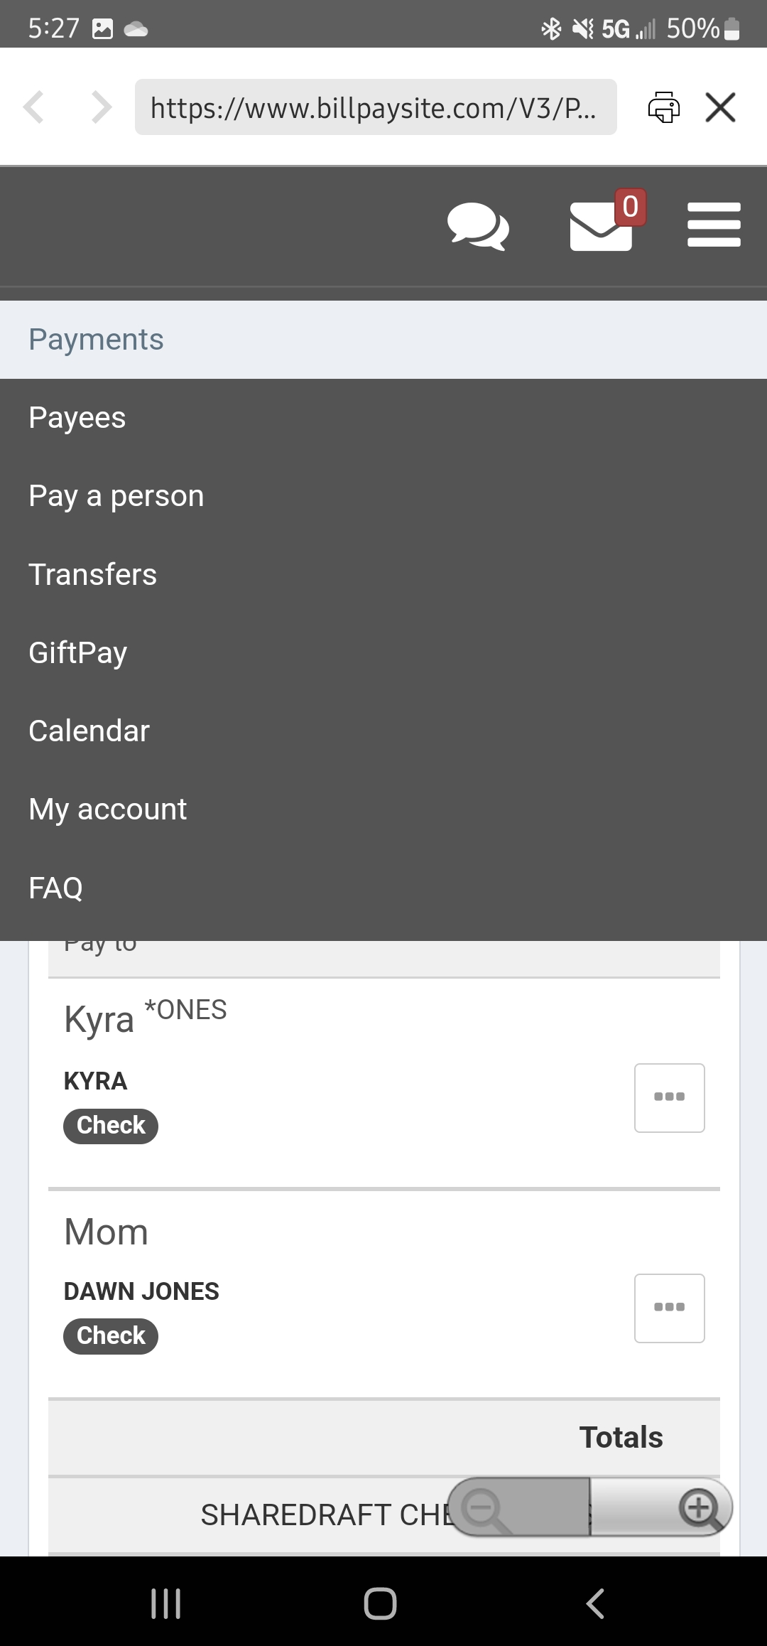
Adding Second Account – Page 1
1. In order to add another account to Bill Pay, the member will need to visit the Bill Pay Site. When they are on the main page, direct them to click on the three vertical lines to expand the menu. If they are on a computer, the “My Account” option should just be along the top menu bar.
5. Once the member has filled it out, have them click “Next”.
3. Then the member will need to click “+Add Account”
4. Here, the member will need to enter their other account number. They can do either the member number + 0500 OR the 12-digit draft ID.
2. Direct the member to click on the “My Account” option.

Slide 35
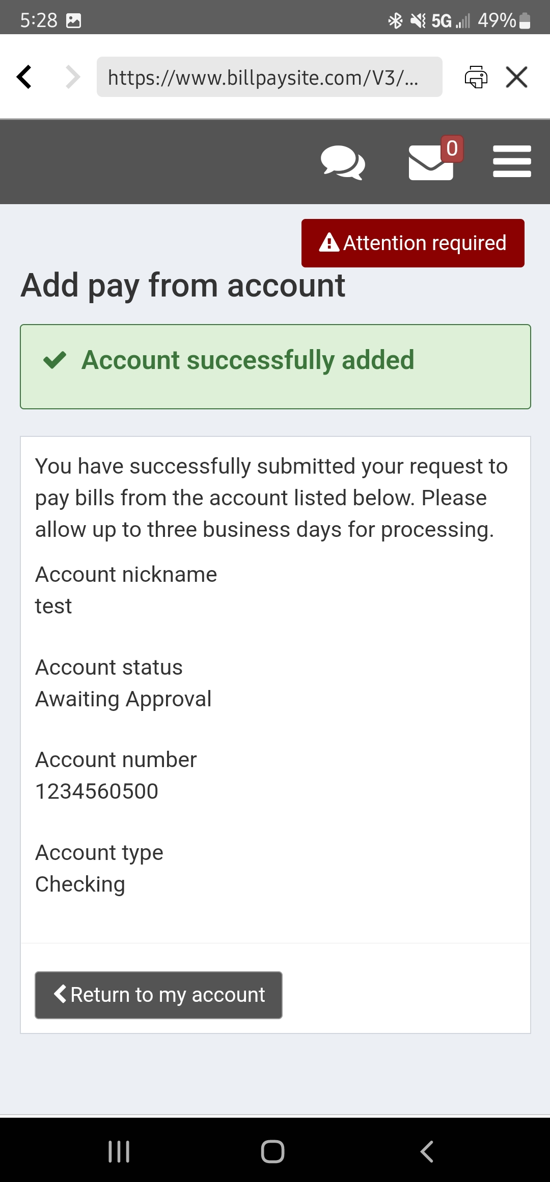
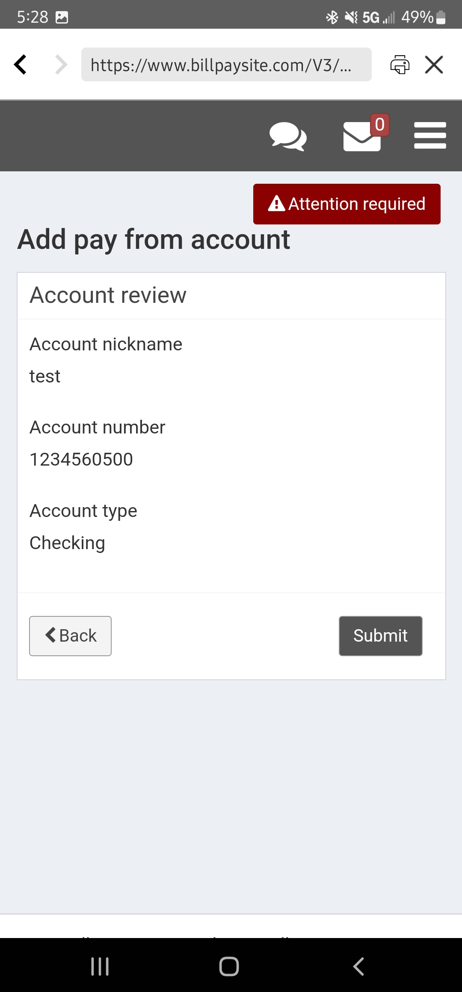
Adding Second Account – Page 2
6. Next they should see the following. They will need to review the information and then hit “Submit”.
7. The member should then be sent to a confirmation page. As it says, the request has now been submitted to us and an e-services representative will need to review it. They will be checking the following things:
a) That the account number is correct
&
b) That the member’s name is on that account

Slide 36
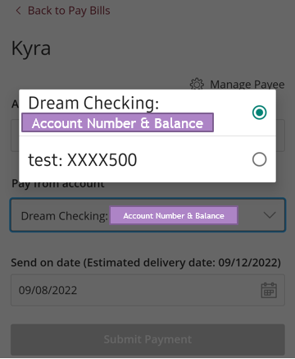
Adding Second Account – Page 3
The member can call us here in the contact center if they want to have the account approved quicker. All supervisors and managers in the contact center should have access to do this.
Once the member has had their additional account approved, it should show up in the dropdown box when the member makes a payment on Home Banking or on the Bill Pay Site. The picture on the right is an example of how it should look.

Slide 37
The End!
This concludes our lesson on Bill Pay. Please don’t hesitate to reach out to the group chat if you have anymore questions.

